Slide 1
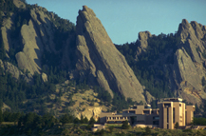
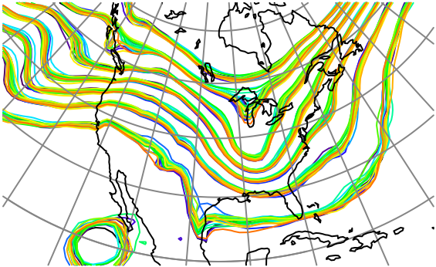

DA and Short-term Prediction Motivate the Need for Careful Software Development In Earth System Models: A Case Study
Jeff Anderson, NCAR Data Assimilation Research Section

Slide 2
A Story About a Finite Volume Atmospheric Dynamical Core
Core originally developed at NASA.
Adopted by GFDL and NCAR for climate investigations.
Simulated at least O(10⁵) years, maybe more.
My team added an ensemble DA capability in 2006.
That’s when we found the following:

Slide 3
Diagnosis of Noise in the CAM Finite Volume core using DART
Kevin Raeder*
Jeff Anderson*
Peter Lauritzen⁺
Tim Hoar*
*NCAR/CISL/IMAGe/DAReS
⁺NCAR/ESSL/CGD/AMPS
The National Center for Atmospheric Research is sponsored by the National Science Foundation.
Notes:
Thanks for the opportunity to present some results of our recent work using CAM in data assimilation experiments.
Today I’ll focus on ….(title)
Jeff did the heavy lifting in developing DART, Peter has helped with analysing our results and working most directly with the CAM code,
Tim helped significantly with this presentation
While I’ve managed the DART-CAM interface as CAM has evolved, assisted users and run and analysed assimilations.

Slide 4
CAM & DART
CAM = 3.5.xx, Finite Volume core, 1.9x2.5, 30 min ∆t.
DART = Data Assimilation Research Testbed, an ensemble Kalman filter data assimilation system.
Assimilate observations used in operational forecasting:
U, V, and T from radiosondes, ACARS, and aircraft,
U and V from satellite cloud drift winds,
every 6 hours to bring CAM as close to the atmosphere as possible, balancing the obs and model errors.
This system is competitive with operational weather centers’ data assimilation systems.
Notes:
One important focus of this effort is to assist with model development,
in the form of diagnosing short term model biases relative to the observations.
While pursuing that we have run into numerical noise in CAM,
which, as far as we are aware, was undetected up to this time.

Slide 5
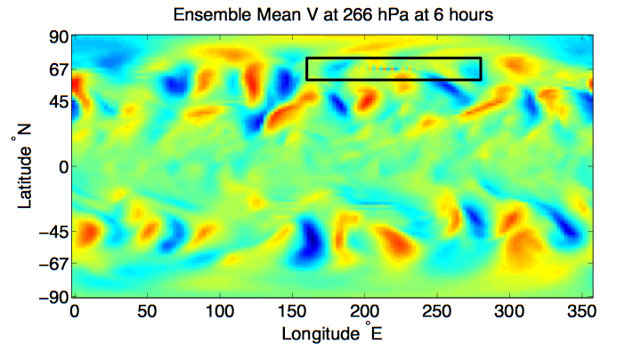
“Houston, we have a Problem.”
CAM FV core - 80 member mean - 00Z 25 September 2006
Notes:
This narrow 2 dx pattern stands out as being rather unphysical.
Assimilation process highlights this, but it's present in free-running CAMs.
Hasn't been noticed because people look at monthly or daily averages, which smooth this out.
Note that this is an ensemble average, so the signal is quite robust.
Some individual ensemble members have larger amplitude noise.

Slide 6
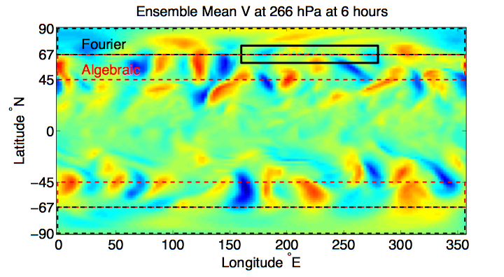
Suspicions turned to the polar filter (DPF)
CAM FV core - 80 member mean - 00Z 25 September 2006
Notes:
Deals with the challenge of meridional resolution increasing at the poles as the meridians converge there.
Act on the U and V tendencies on the C grid (mild filtering)
The default filter consists of an algebraic, or digital, filter starting weakly at latitudes of ~45 degrees,
then increasing poleward to latitude 67, where there’s a hard transition to a fourier filter.
You can see that the transition from one filter to the other almost completely obscures the noise.

Slide 7
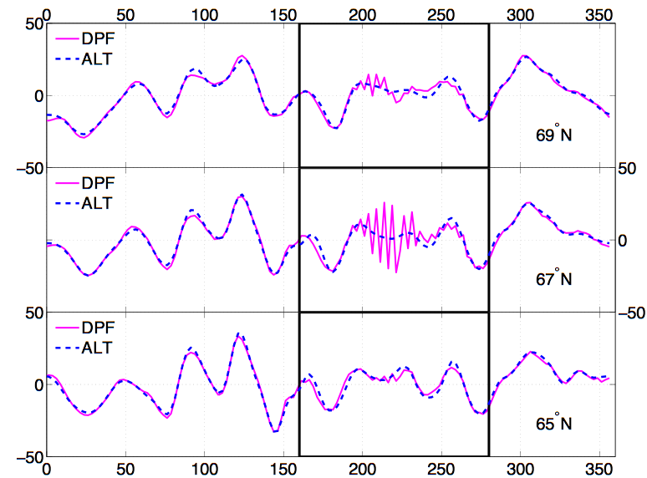
Three adjacent E-W cross-sections from the region of the discontinuity reveal more detail.
m/s
m/s
m/s
East Longitude
Ensemble Mean V @ 266hPa - 00Z 25 Sep 2006 - CAM FV core
Notes:
The default polar filter is the solid line. The dashed line is the pure fourier filter.
We can see here that the noise has the same amplitude as the signal
But is completely eliminated by the pure fourier filter.
Peter Laurizten and Art Mirin are installing an improved, more flexible form of the polar filter in CAM,
which can eliminate this noise, while appropriately filtering the fields.

Slide 8
Combination of algebraic filter and polar Fourier filter
Original: Both fourier and algebraic get more dissipative between 41 and 68 degrees. Then algebraic turns off.
Notes:
The default polar filter is the solid line. The dashed line is the pure fourier filter.
We can see here that the noise has the same amplitude as the signal
But is completely eliminated by the pure fourier filter.
Peter Laurizten and Art Mirin are installing an improved, more flexible form of the polar filter in CAM,
which can eliminate this noise, while appropriately filtering the fields.

Slide 9
Combination of algebraic filter and polar Fourier filter
Unclear what actual intent was. Probably to turn algebraic off gradually between 41 and 68?
Notes:
The default polar filter is the solid line. The dashed line is the pure fourier filter.
We can see here that the noise has the same amplitude as the signal
But is completely eliminated by the pure fourier filter.
Peter Laurizten and Art Mirin are installing an improved, more flexible form of the polar filter in CAM,
which can eliminate this noise, while appropriately filtering the fields.

Slide 10
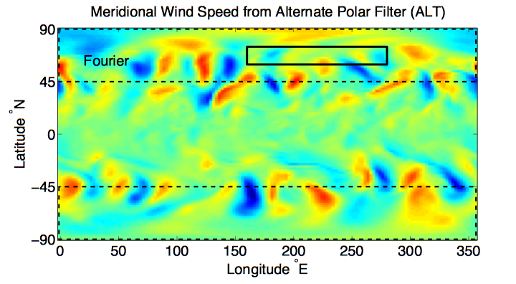
Using a continuous polar filter
(alt-pft) does not show this effect.
Ensemble Mean V @ 266hPa - 00Z 25 Sep 2006 - CAM FV core
Notes:
in CAMs before 3.5.20 the ALT_PFT compile option replaces the digital filter with a more extensive fourier filter (41-pole).
It filters the winds (not tendencies) on the D-grid, which is a stronger filter, and is continuous from 45 degrees to the pole.

Slide 11
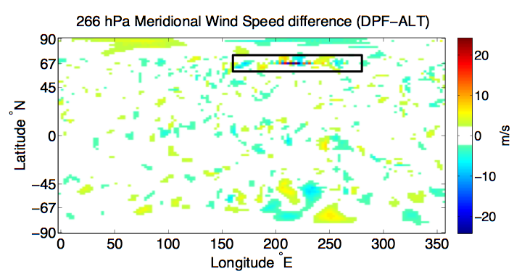
The differences are minimal except at the transition region of the default polar filter.
Ensemble Mean V @ 266hPa - 00Z 25 Sep 2006 - CAM FV core
Notes:
This is the difference in meridional wind speed between 6 hour forecasts taken from assimilations using the default polar filter and the pure fourier filter.
The differences are only a few m/s EXCEPT where the noise created +/- 20 m/s grid point variations.

Slide 12
That wasn’t so bad!
The use of DA diagnosed a problem that had been unrecognized (or at least undocumented).
The problem can be seen in ‘free runs’ - it is not a data assimilation artifact.
Without assimilation, can’t get reproducing occurrences to diagnose.
Could have an important effect on any physics in which meridional mixing is important.
The alternate polar filter ‘fixes’ this problem.

Slide 13
Benefits of Ensemble DA for Model Development
Confront model with observations, look for inconsistencies.
Create reproducible, realistic model cases.
Enable study of particular events.
Compare to existing models for these cases.
Sensitivity analysis, correlate any function of state with any function of state.
Direct estimation of model parameters.
Notes:
Slide 7: GPS occultation forward operators
Non-local refractivity : (Sokolovskiy et al., MWR 133, 2200-2212)
NEED DETAILS OF ALGORITHM step size???
upper limits
grid pictures for different latitudes
Three pictures exist: ~jla/talks_and_meetings/2009/ams/cam_gps_talk/gps_lat*
Expect minor differences with coarse grid, larger near poles

Slide 14
Model Design Requirements for Ensemble DA
Results from NCAR Singletrack project,
Working group on Data Assimilation.
Notes:
Slide 7: GPS occultation forward operators
Non-local refractivity : (Sokolovskiy et al., MWR 133, 2200-2212)
NEED DETAILS OF ALGORITHM step size???
upper limits
grid pictures for different latitudes
Three pictures exist: ~jla/talks_and_meetings/2009/ams/cam_gps_talk/gps_lat*
Expect minor differences with coarse grid, larger near poles

Slide 15
Model Design Requirements for Ensemble DA
Can perform a sequence of short integrations with minimal computational overhead relative to a single long integration.
Can stop and restart exactly.
Precise, accessible definition of prognostic state.
Easy to invoke a range of damping and smoothing operators so that model is stable when using DA.
Ability to access and modify model parameters.
Compute forward operators efficiently at high frequency.
Tangent linear capability and adjoint model capability?
Tangent linear and adjoint for forward operators?
Notes:
Slide 7: GPS occultation forward operators
Non-local refractivity : (Sokolovskiy et al., MWR 133, 2200-2212)
NEED DETAILS OF ALGORITHM step size???
upper limits
grid pictures for different latitudes
Three pictures exist: ~jla/talks_and_meetings/2009/ams/cam_gps_talk/gps_lat*
Expect minor differences with coarse grid, larger near poles

Slide 16
Software Engineering for Living Science Codes
This code was used at 3 major institutions.
At least O(10⁵) years of model integration.
It is obviously incorrect.
Leads to clearly visible concerns in instantaneous fields.
Why didn’t anybody notice?
Notes:
Slide 7: GPS occultation forward operators
Non-local refractivity : (Sokolovskiy et al., MWR 133, 2200-2212)
NEED DETAILS OF ALGORITHM step size???
upper limits
grid pictures for different latitudes
Three pictures exist: ~jla/talks_and_meetings/2009/ams/cam_gps_talk/gps_lat*
Expect minor differences with coarse grid, larger near poles

Slide 17
Software Engineering for Living Science Codes
Why didn’t anybody notice?
Model doesn’t crash.
There is no first principles algorithm.
There is no unit test available (or possible?).
In long runs, no simple ‘test’ for bad behavior?
This piece of code was used to ‘tune’ model behavior.
It clearly evolved after original writing.
The code contained negligible documentation.
The code is difficult to interpret.
Code path is controlled by a number of external parameters.
Notes:
Slide 7: GPS occultation forward operators
Non-local refractivity : (Sokolovskiy et al., MWR 133, 2200-2212)
NEED DETAILS OF ALGORITHM step size???
upper limits
grid pictures for different latitudes
Three pictures exist: ~jla/talks_and_meetings/2009/ams/cam_gps_talk/gps_lat*
Expect minor differences with coarse grid, larger near poles

Slide 18
Software Engineering for Living Science Codes
Why didn’t anybody notice?
!************
! Cell center
!************
do j=js2g0,jn2g0
sc(j) = (coszc/cosp(j))**2
if(sc(j) > D1_0 ) then
if(fft_flt .eq. 0 .and. sc(j) <= D2_0) then
sc(j) = D1_0 + (sc(j)-D1_0)/(sc(j)+D1_0)
elseif(fft_flt .eq. 0 .and. sc(j) <= D4_0) then
sc(j) = D1_0 + sc(j)/(D8_0-sc(j))
else
! FFT filter
do i=1,im/2
phi = dl * i
damp = min((cosp(j)/coszc)/sin(phi),D1_0)**2
if(damp < cutoff) damp = D0_0
dc(2*i-1,j) = damp
dc(2*i ,j) = damp
enddo
endif
endif
enddo
Notes:
Slide 7: GPS occultation forward operators
Non-local refractivity : (Sokolovskiy et al., MWR 133, 2200-2212)
NEED DETAILS OF ALGORITHM step size???
upper limits
grid pictures for different latitudes
Three pictures exist: ~jla/talks_and_meetings/2009/ams/cam_gps_talk/gps_lat*
Expect minor differences with coarse grid, larger near poles

Slide 19
Software Engineering for Living Science Codes
Axioms:
Scientists aren’t software engineers,
Software engineers aren’t scientists,
Both fields require non-trivial expertise.
Scientists should do careful science.
Software engineers should do careful engineering.
Should work closely together during implementation.
Notes:
Slide 7: GPS occultation forward operators
Non-local refractivity : (Sokolovskiy et al., MWR 133, 2200-2212)
NEED DETAILS OF ALGORITHM step size???
upper limits
grid pictures for different latitudes
Three pictures exist: ~jla/talks_and_meetings/2009/ams/cam_gps_talk/gps_lat*
Expect minor differences with coarse grid, larger near poles

Slide 20
Software Engineering for Living Science Codes
Scientists should do careful science:
Precise, reproducible, documented, justified.
SEs should do careful engineering:
All code should be clear, documented.
Separation of development from supported code.
Pair should confirm that code does what scientists want.
Notes:
Slide 7: GPS occultation forward operators
Non-local refractivity : (Sokolovskiy et al., MWR 133, 2200-2212)
NEED DETAILS OF ALGORITHM step size???
upper limits
grid pictures for different latitudes
Three pictures exist: ~jla/talks_and_meetings/2009/ams/cam_gps_talk/gps_lat*
Expect minor differences with coarse grid, larger near poles

Slide 21
Software Engineering for Living Science Codes
Key points:
Highly unlikely that any existing GCM is ‘error-free’
How can one interpret results from something known to be erroneous.
Subsequent developments may be compensatory.
My opinion:
Much more careful development is essential.
Much more comprehensive unit testing where possible.
Far more important than new parameterizations, etc.
Notes:
Slide 7: GPS occultation forward operators
Non-local refractivity : (Sokolovskiy et al., MWR 133, 2200-2212)
NEED DETAILS OF ALGORITHM step size???
upper limits
grid pictures for different latitudes
Three pictures exist: ~jla/talks_and_meetings/2009/ams/cam_gps_talk/gps_lat*
Expect minor differences with coarse grid, larger near poles

Slide 22
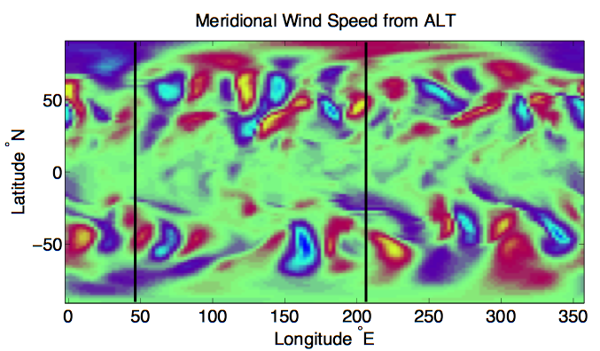
2 ∆y noise in ensemble average V
More suspicious patterns, not fixed by ALT_PFT
Ensemble Mean V @ 266hPa CAM FV core 00Z 25 September 2006
Notes:
This is the same case I just showed, but it was run with the ALT_PFT option.
We’re again looking at an ensemble average 6 hour forecast of the meridional wind.
There appears to be a 2 dy noise at several locations.
To see details we’ll look at these 2 cross sections.

Slide 23
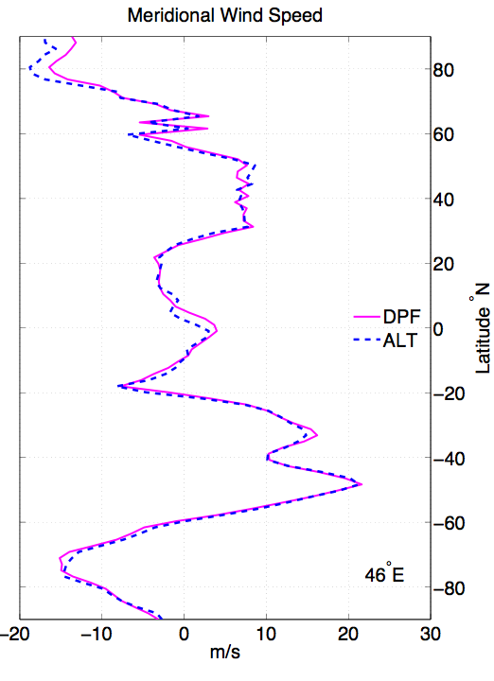
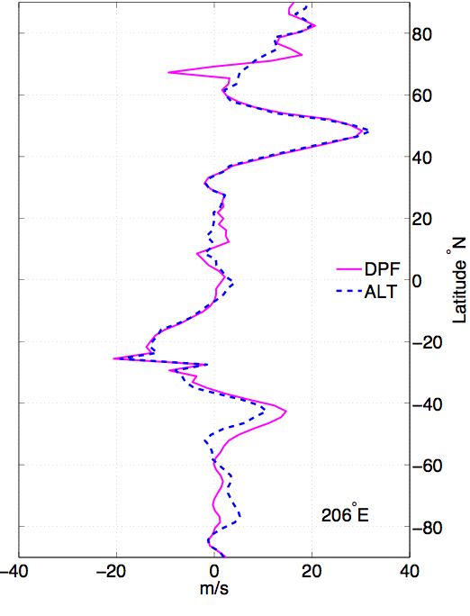
North-South cross sections
46º East
206º East
Polar filter
noise (fixed)
Residual
Noise
Residual
Noise
Ensemble Mean V @ 266hPa CAM FV core 00Z 25 September 2006
Notes:
In this cross section from 260 East we see that the polar filter noise (the solid line) is gone,
But at other locations there’s still grid point noise in V.

Slide 24
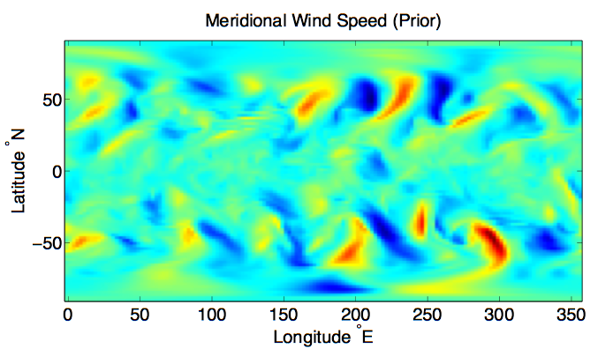
Another instance of noise from real-time use of DART-CAM in a chemistry field campaign (ARCTAS)
6 hour forecast of a single ensemble member
Ensemble Member 10 V @ 266hPa CAM FV core 06Z 13 April 2008
Notes:
[Read caption]
The date is April 13 2008.
This is again a 6 hour forecast taken from an assimilation with the ALT_PFT CAM.
This is prior to the assimilation of observations at this time.
Note the striping at 125 E as I go to the next slide, which is the field after assimilation of obs
[Ensemble member 10
April 13 … assimilation started on ? From ? Initial conditions
Colorbar normalized to data limits

Slide 25
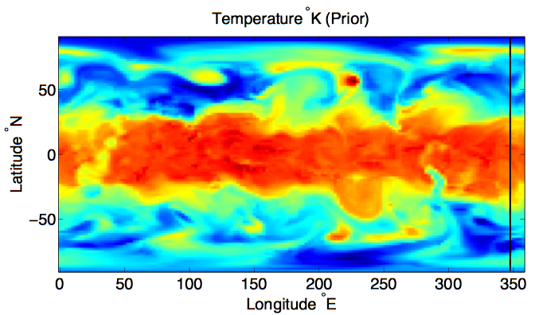
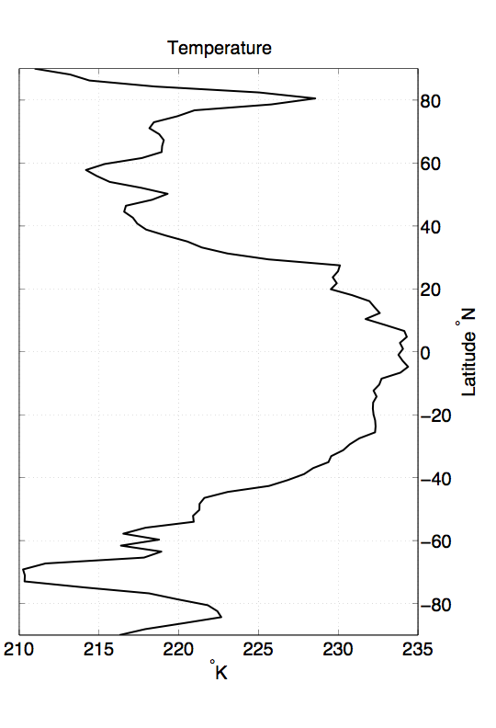
Noise not restricted to V winds …
suspicious
Ensemble Member 10 T @ 266hPa CAM FV core 06Z 13 April 2008

Slide 26
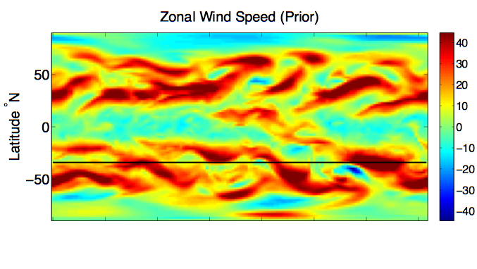
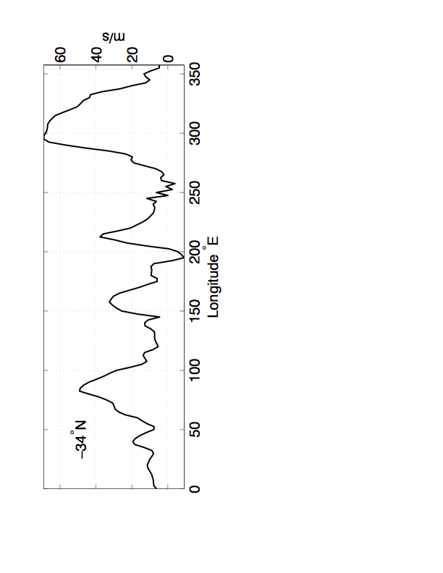
suspicious
Ensemble Member 10 U @ 266hPa CAM FV core 06Z 13 April 2008
Notes:
This dU/dx and dV/dy suggests a problem with divergence damping, but first we took
Christiana Jablonowski's suggestion that the dynamical time splitting was only marginally
stable at its default value of 4.

Slide 27
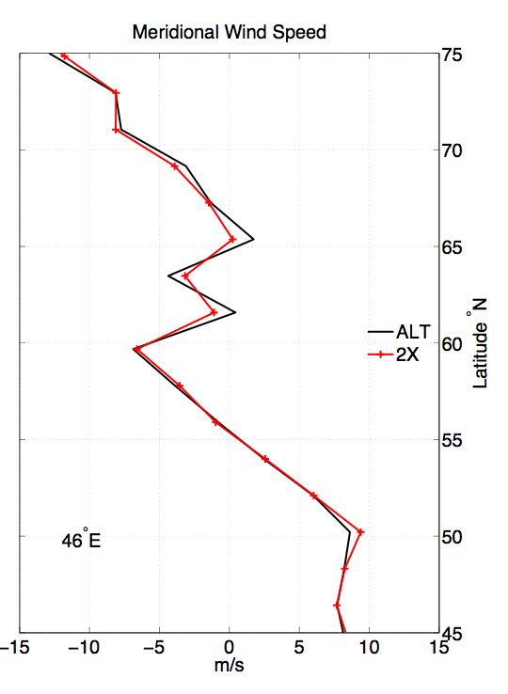
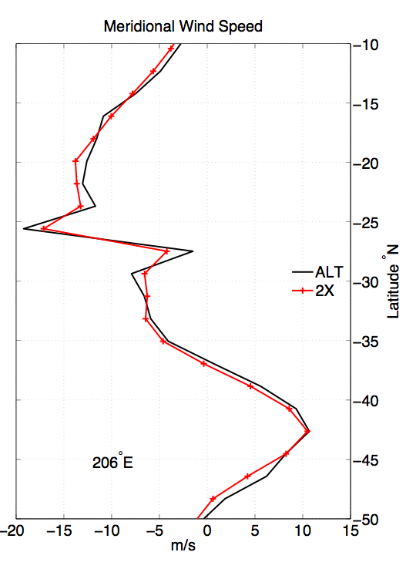
Doubling the dynamical time splitting reduced the noise; implicates model as opposed to assimilation.
Ensemble Mean V @ 266hPa CAM FV core 00Z 25 September 2006
Notes:
Up to 50% improvement in this noise,
but I have to conclude that the glass is half empty.

Slide 28
Notes and Conclusions
The noise here may seem small and transient,
but since it had not been recognized by any of the labs
that used this FV core, the effects on climate
runs were not explored.
Spurious mixing is happening.
Parameterizations may have been mistuned.
More time may need to be spent fixing the remaining noise and looking at other unexamined pieces of the code.

Slide 29
Conclusions
Existing GCMs contain unknown errors.
These errors affect model results in unknown ways.
Prediction using data assimilation can help reveal some model problems.
Tracing problems to errors can be extremely difficult.
Vastly improved development process is required for trustworthy models.
Notes:
Slide 7: GPS occultation forward operators
Non-local refractivity : (Sokolovskiy et al., MWR 133, 2200-2212)
NEED DETAILS OF ALGORITHM step size???
upper limits
grid pictures for different latitudes
Three pictures exist: ~jla/talks_and_meetings/2009/ams/cam_gps_talk/gps_lat*
Expect minor differences with coarse grid, larger near poles

Slide 30
www.image.ucar.edu/DAReS/DART

