Slide 1
Introduction to Data Assimilation Jeff Anderson representing the NCAR Data Assimilation Research Section

Slide 2
Outline
Data Assimilation: Building a simple forecast system.
Data Assimilation: What can it do?
Data Assimilaton: A general description.
Methods: Particle filter.
Methods: Variational.
Methods: Kalman filter.
Methods: Ensemble Kalman filter.
Additional topics.

Slide 3
Data Assimilation: Building a simple forecast system
Want to predict where the ball will land.

Slide 4
Data Assimilation: Building a simple forecast system
Prediction Model

Slide 5
Data Assimilation: Building a simple forecast system
Prediction Model
For the ball this is simple:

Slide 6
Data Assimilation: Building a simple forecast system
Prediction Model
For the ball this is simple:
However, may be uncertain about initial conditions:
x_{initial}, y_{initial}, u_{initial} and v_{initial}

Slide 7
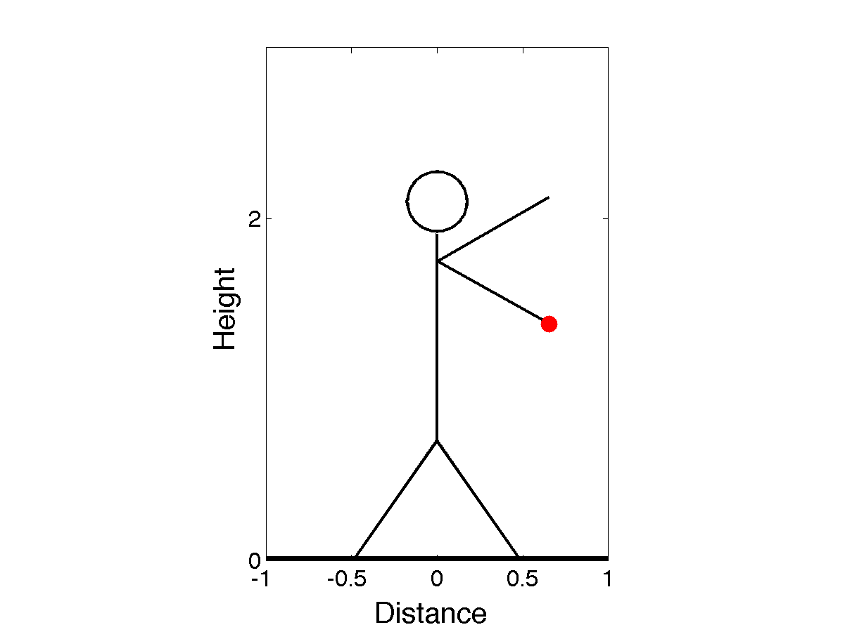
Data Assimilation: Building a simple forecast system
Only know probability distribution about the throw.
Uncertainty in these leads to uncertainty in x, y, u, v.
Position of shoulder.
Release angle.
Arm length.
Speed of arm.

Slide 8
Data Assimilation: Building a simple forecast system
Sample this with an ‘ensemble’ of balls with random draws from the thrower.

Slide 9
Data Assimilation: Building a simple forecast system
Prediction Model
Observing System
Need observations (measurements) of the red ball.
All observations have errors.
Observe position of ball every half second after throw.

Slide 10
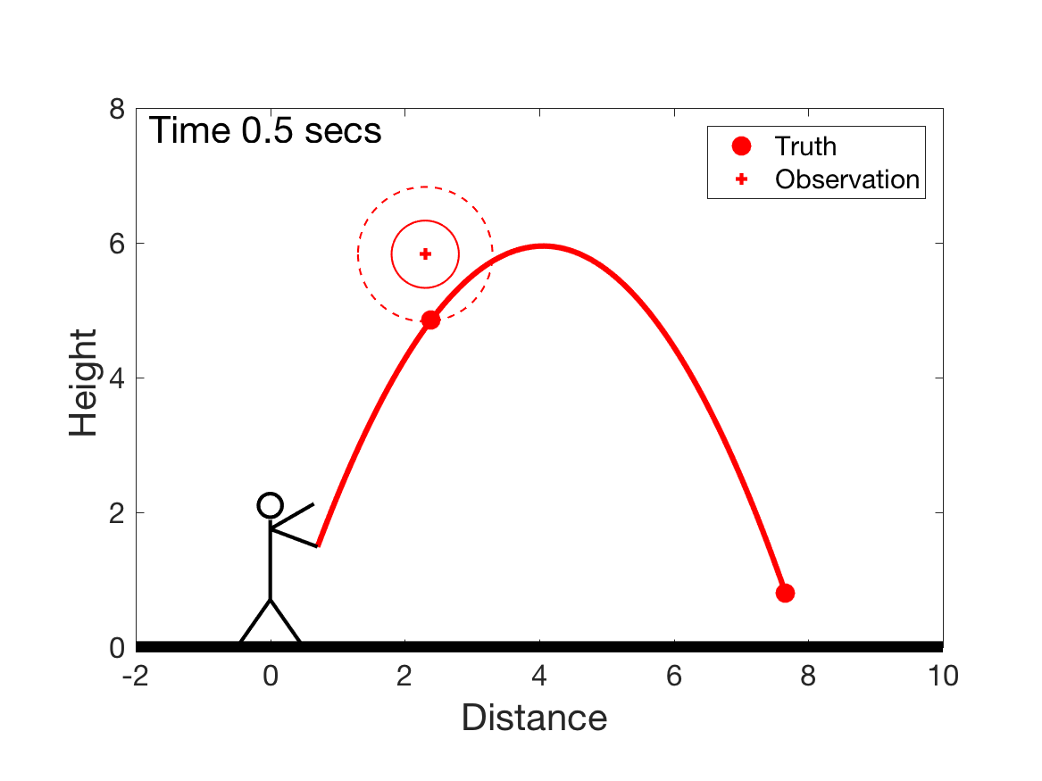
Data Assimilation: Building a simple forecast system
Observations of the red ball.

Slide 11
Data Assimilation: Building a simple forecast system
Observations of the red ball.

Slide 12
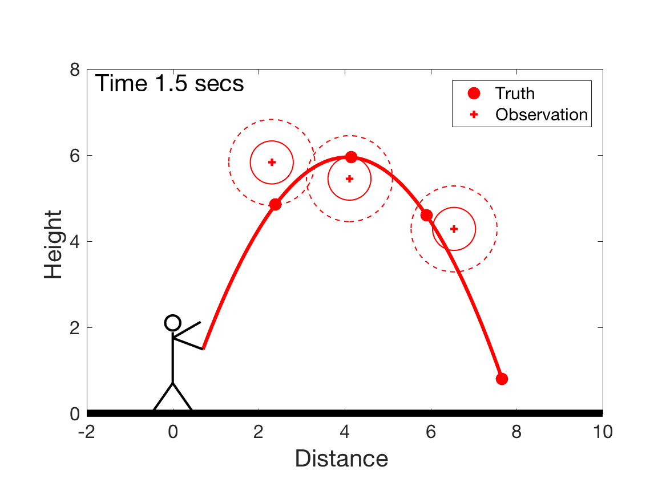
Data Assimilation: Building a simple forecast system
Observations of the red ball.

Slide 13
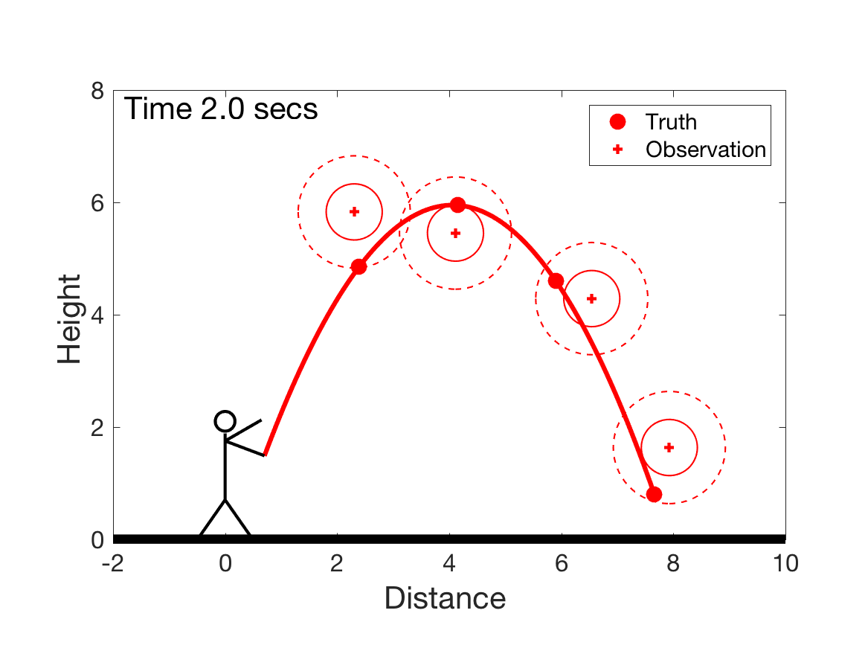
Data Assimilation: Building a simple forecast system
Observations of the red ball.

Slide 14
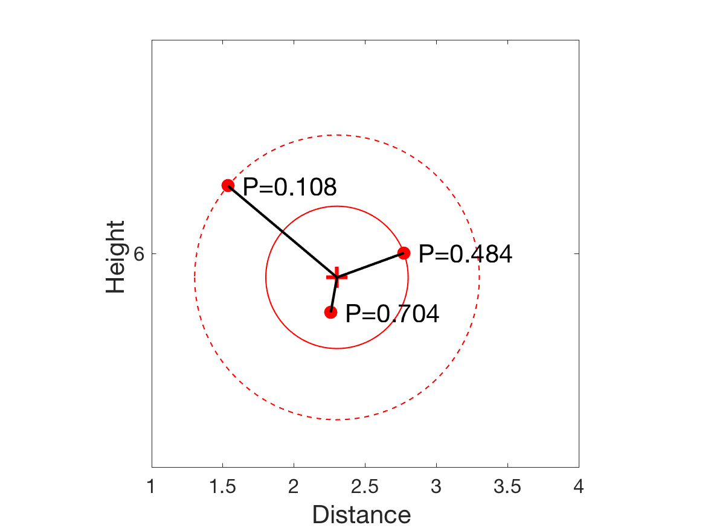
Data Assimilation: Building a simple forecast system
Observation error is normal (gaussian).
Probability (likelihood) of sample states shown.
$P=\frac{1}{\sqrt{2πσ^{2}}}e^{\frac{−d^{2}}{2σ^{2}}}$ (from definition of normal).
2$σ$
Solid circle is 1 standard deviation, $σ$.
Dashed circle is 2 standard deviations, $2σ$.
(x and y errors uncorrelated)
$$σ$$

Slide 15
Data Assimilation: Building a simple forecast system
Prediction Model
Observing System
Observations
Forecasts
Data Assimilation

Slide 16
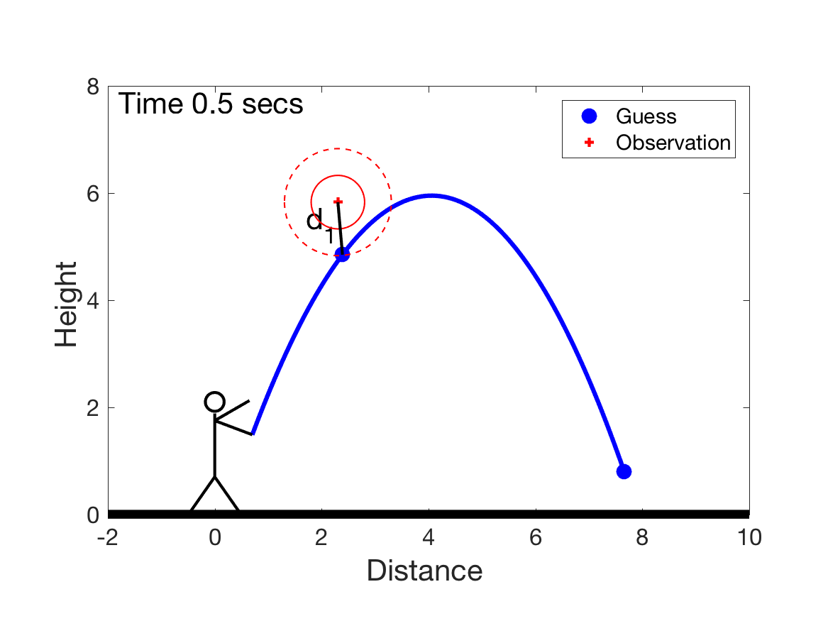
Data Assimilation: Building a simple forecast system
For one obesrvation, likelihood of trajectory is:
$$P=\frac{1}{\sqrt{2π{σ_{1}}^{2}}}e^{\frac{−d_{1}^{2}}{2σ_{1}^{2}}}$$

Slide 17
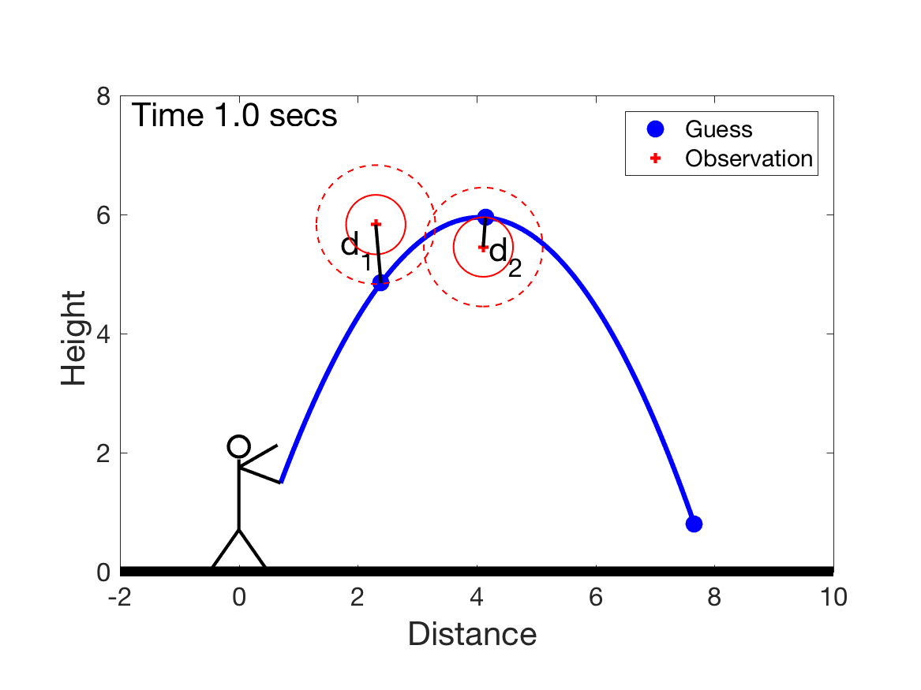
Data Assimilation: Building a simple forecast system
For many observations, product of likelihoods
$$P=\frac{1}{\sqrt{2π{σ_{1}}^{2}}}e^{\frac{−d_{1}^{2}}{2σ_{1}^{2}}}\frac{1}{\sqrt{2π{σ_{2}}^{2}}}e^{\frac{−d_{2}^{2}}{2σ_{2}^{2}}}$$

Slide 18
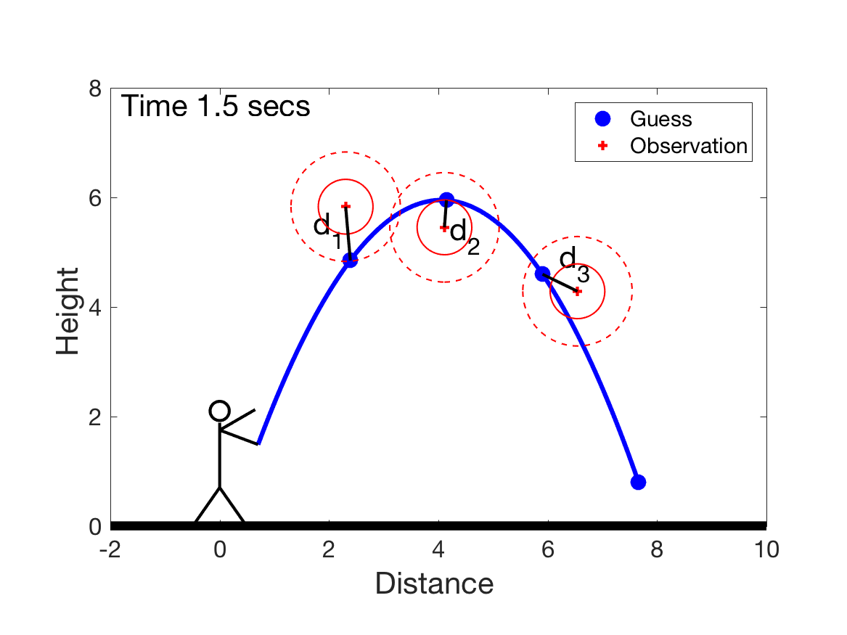
Data Assimilation: Building a simple forecast system
For many observations, product of likelihoods
$$P=\frac{1}{\sqrt{2π{σ_{1}}^{2}}}e^{\frac{−d_{1}^{2}}{2σ_{1}^{2}}}\frac{1}{\sqrt{2π{σ_{2}}^{2}}}e^{\frac{−d_{2}^{2}}{2σ_{2}^{2}}}\frac{1}{\sqrt{2π{σ_{3}}^{2}}}e^{\frac{−d_{3}^{2}}{2σ_{3}^{2}}}$$

Slide 19
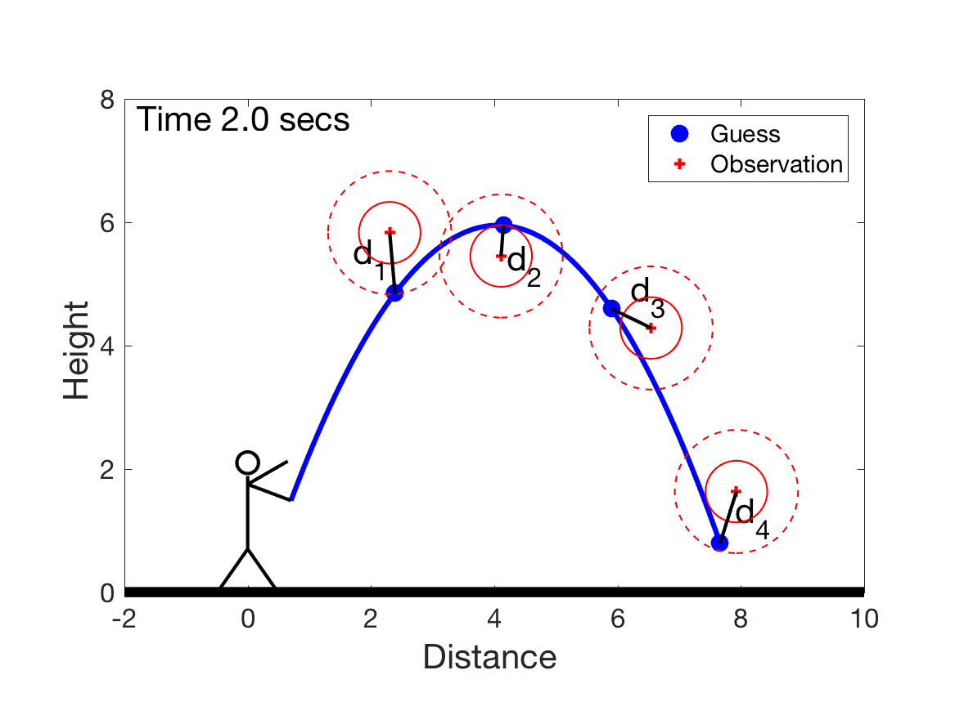
Data Assimilation: Building a simple forecast system
For many observations, product of likelihoods
$$P=\frac{1}{\sqrt{2π{σ_{1}}^{2}}}e^{\frac{−d_{1}^{2}}{2σ_{1}^{2}}}\frac{1}{\sqrt{2π{σ_{2}}^{2}}}e^{\frac{−d_{2}^{2}}{2σ_{2}^{2}}}\frac{1}{\sqrt{2π{σ_{3}}^{2}}}e^{\frac{−d_{3}^{2}}{2σ_{3}^{2}}}\frac{1}{\sqrt{2π{σ_{4}}^{2}}}e^{\frac{−d_{4}^{2}}{2σ_{4}^{2}}}$$

Slide 20
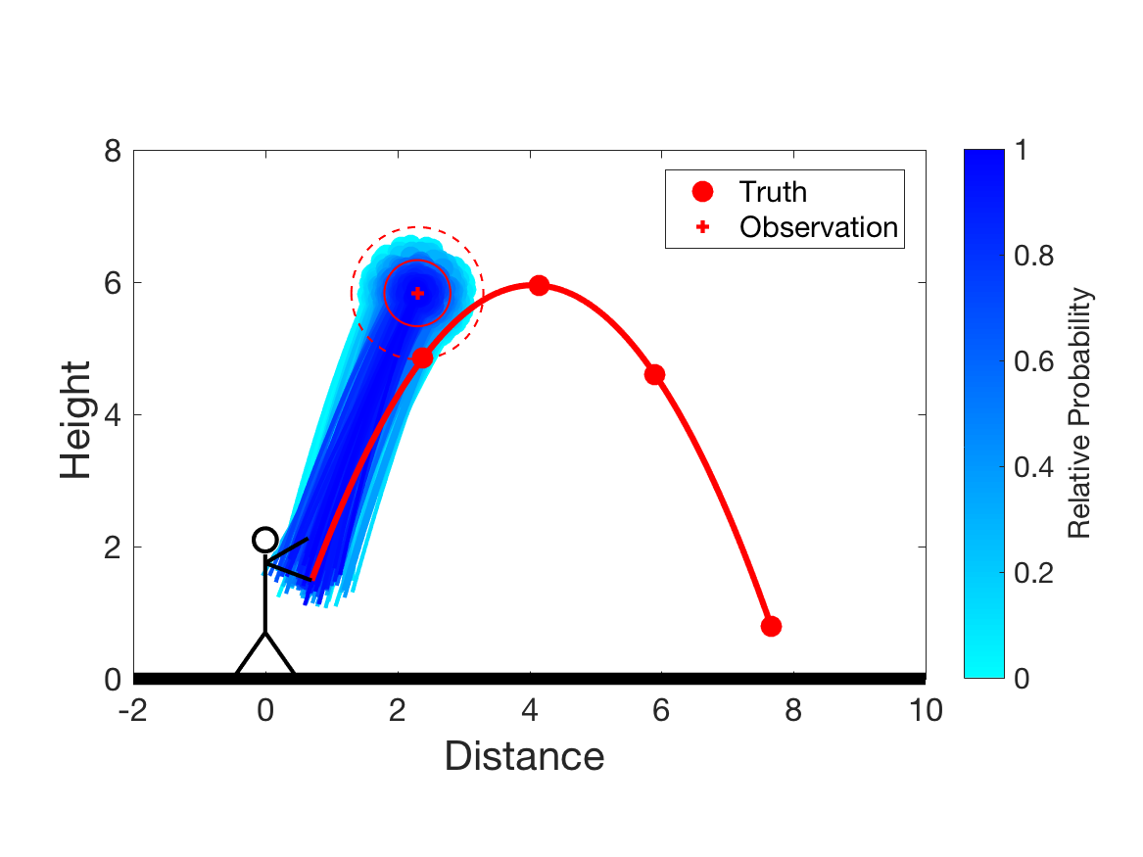
Data Assimilation: Building a simple forecast system
Assimilating the first observation:
Make large ensemble of forecasts.
Use first observation to assign relative probability.
500 most likely of 10000 (darker blue => more likely).

Slide 21
Data Assimilation: Building a simple forecast system
Assimilating the first observation:
500 balls at time 0.5 are an ensemble analysis.
Show uncertainty of best estimate of red ball’s location.

Slide 22
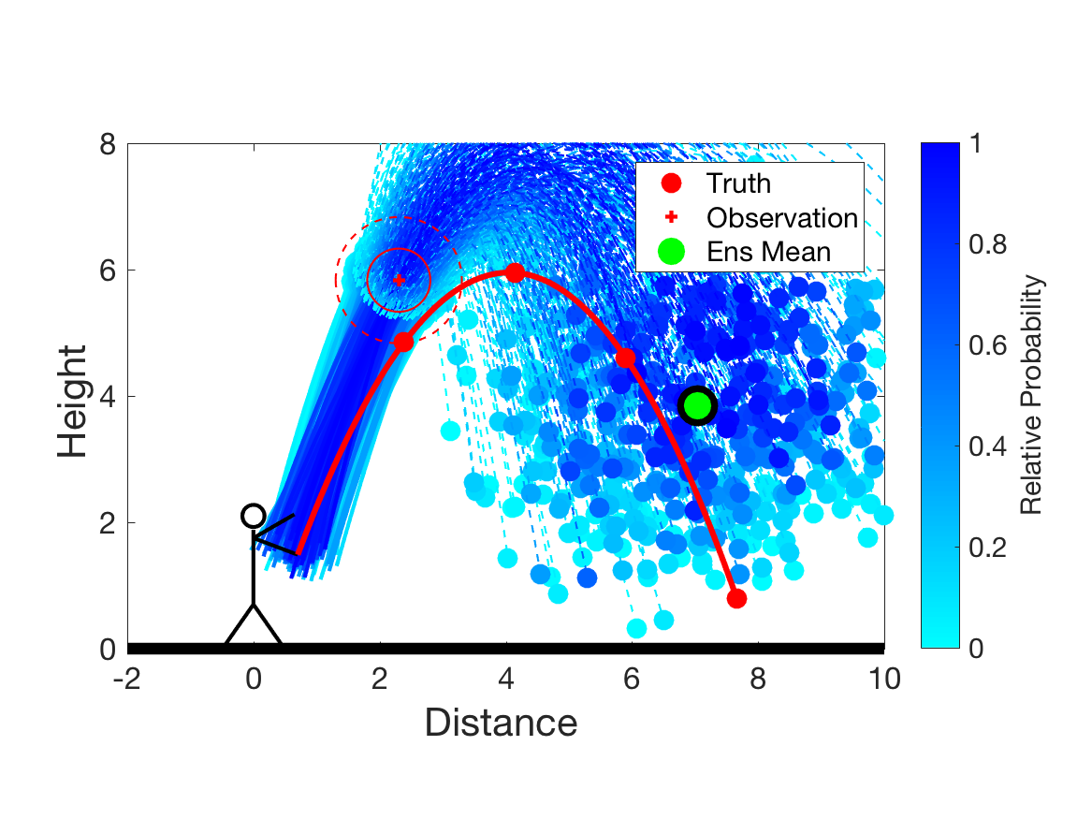
Data Assimilation: Building a simple forecast system
Assimilating the first observation:
Can make a forecast to later times.
Green is probability weighted ensemble mean.
Best estimate of the ball’s position after 2 seconds.

Slide 23
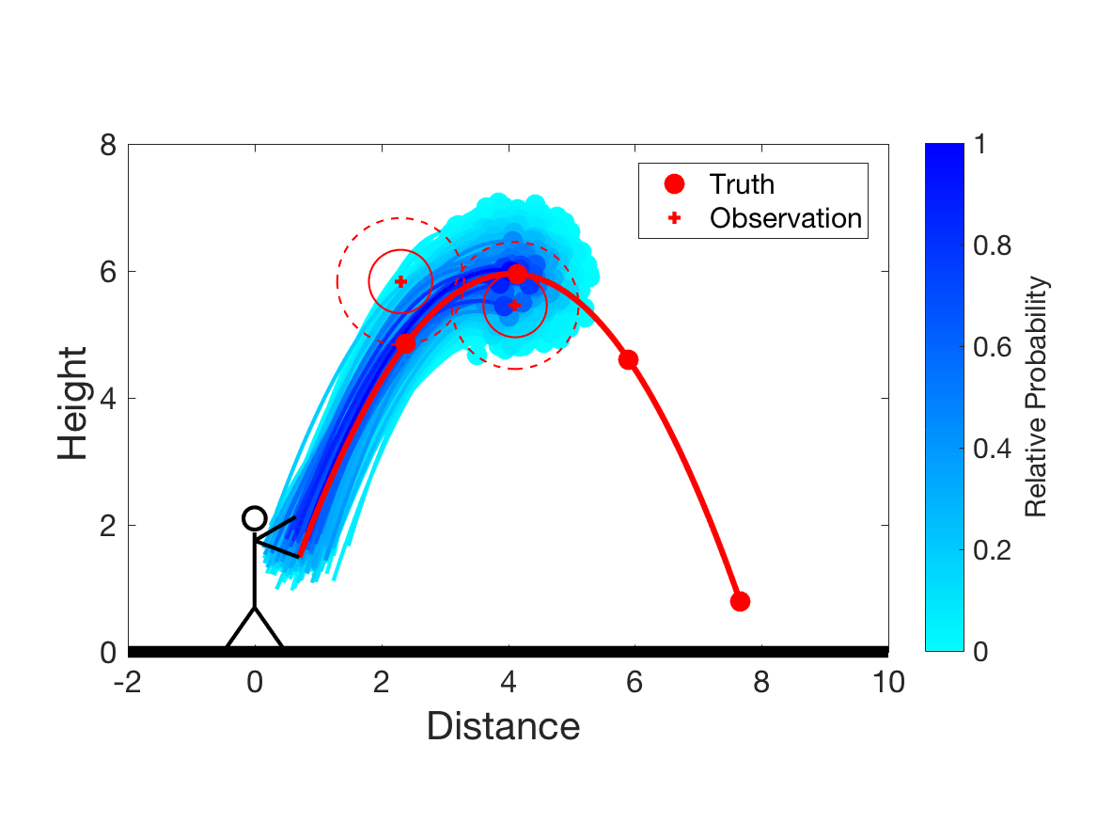
Data Assimilation: Building a simple forecast system
Assimilating the second observation:
Can include observations from subsequent times.
Analysis using observations at 0.5 and 1 seconds shown.

Slide 24
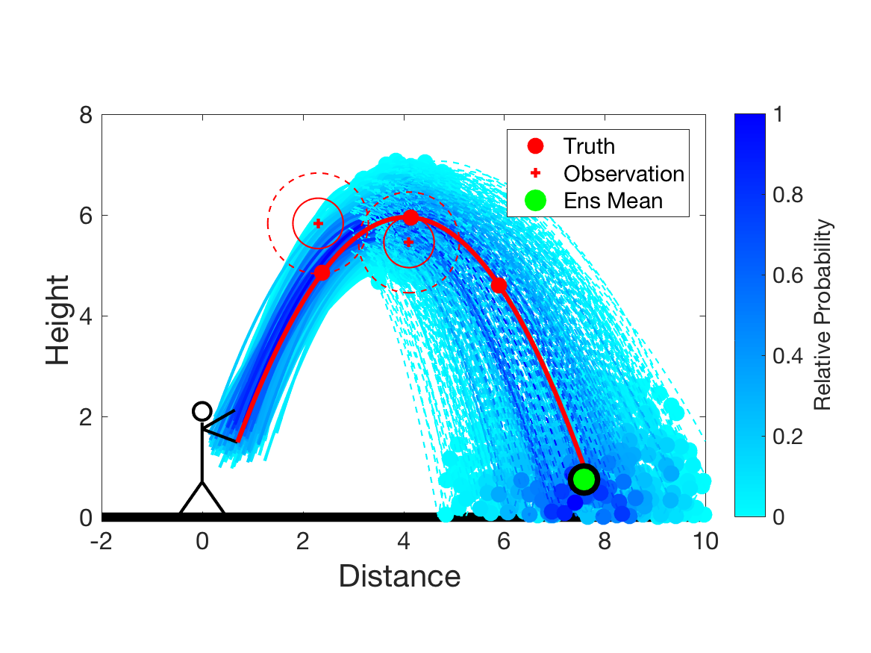
Data Assimilation: Building a simple forecast system
Assimilating the second observation:
Can include observations from subsequent times.
Forecast using observations at 0.5 and 1 seconds shown.

Slide 25
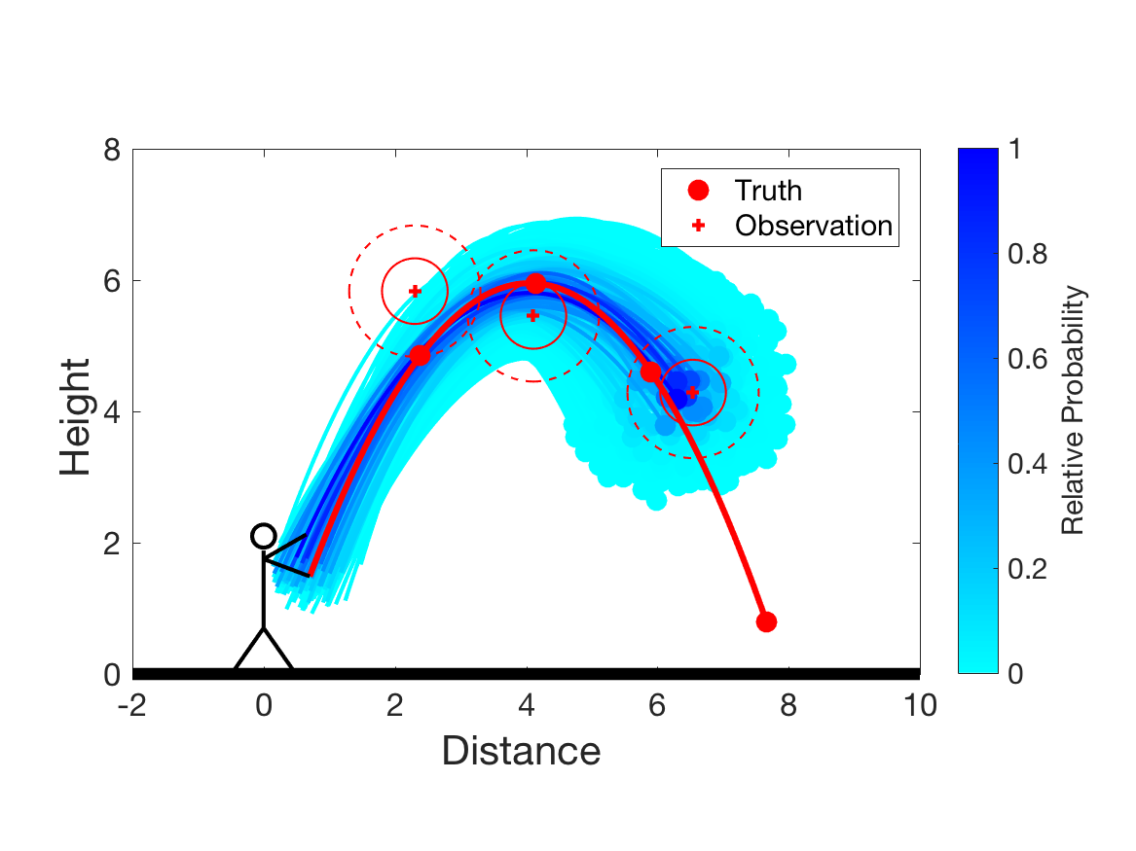
Data Assimilation: Building a simple forecast system
Assimilating the third observation:
Analysis using observations at 0.5, 1, 1.5 seconds shown.

Slide 26
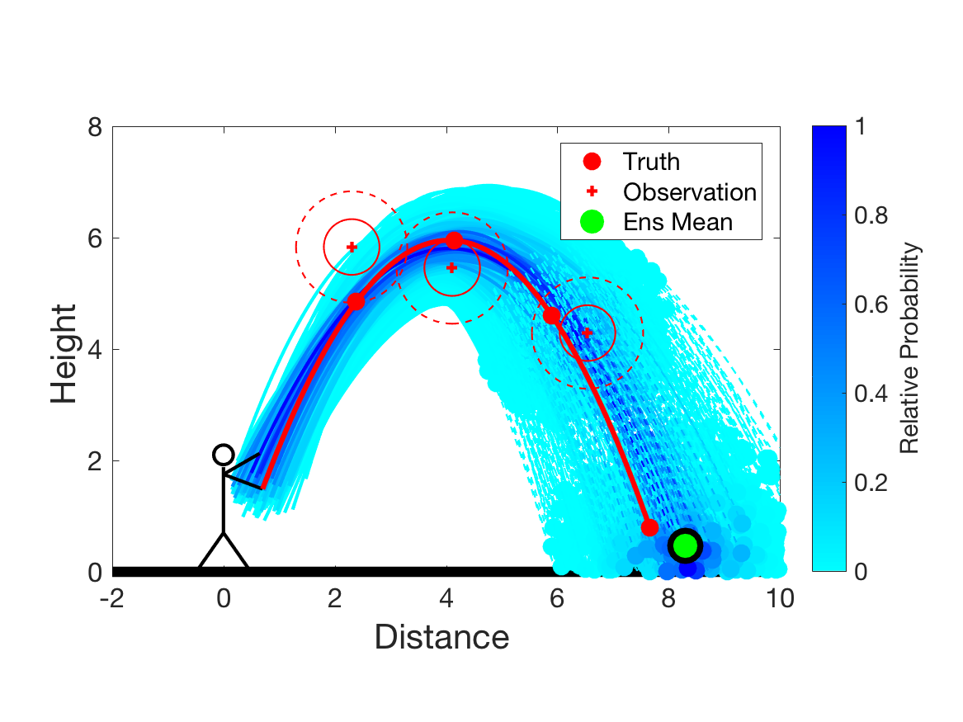
Data Assimilation: Building a simple forecast system
Assimilating the third observation:
Forecast using observations at 0.5, 1, 1.5 seconds shown.

Slide 27
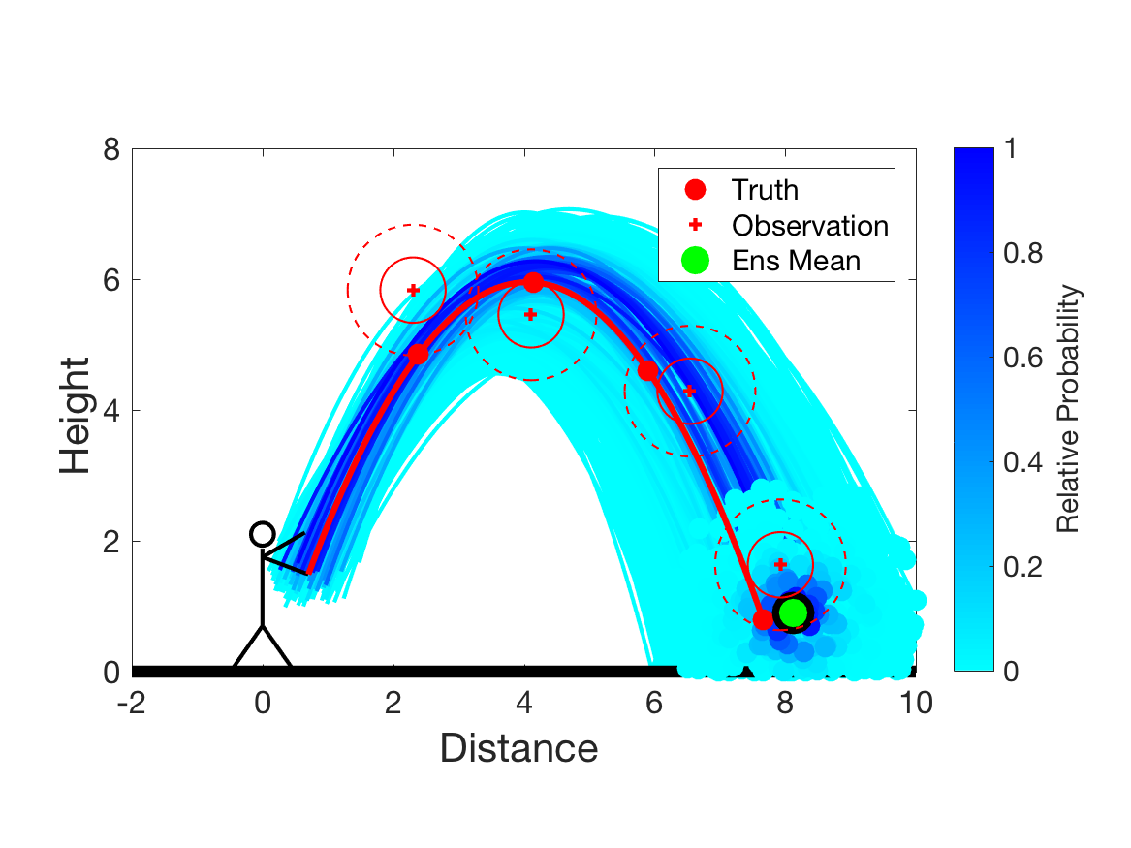
Data Assimilation: Building a simple forecast system
Assimilating the final observation:
Analysis using observations at 0.5, 1, 1.5, 2 seconds.

Slide 28
Data Assimilation: Building a simple forecast system
Data assimilation combines model and observations.
Analyses and forecasts are always uncertain.
Analyses become more accurate, more certain with more observations.
Shorter lead forecasts are more accurate, more certain.
Quantifying this uncertainty is important.

Slide 29
Outline
Data Assimilation: Building a simple forecast system.
Data Assimilation: What can it do?
Data Assimilaton: A general description.
Methods: Particle filter.
Methods: Variational.
Methods: Kalman filter.
Methods: Ensemble Kalman filter.
Additional topics.

Slide 30
Data Assimilation: What can it do?
Analyses more accurate, more certain with more observations.
Shorter lead forecasts are more accurate, more certain.
Can also improve estimate using future observations;
this is called smoothing.
Information about the thrower can also be obtained;
this is called initial condition estimation.

Slide 31
Data Assimilation: What can it do?
As more observations are used, forecast for time two seconds generally improves and has less uncertainty.
After 1st Observation
Smoothing
Forecast
Analysis
Initial condition

Slide 32
Data Assimilation: What can it do?
As more observations are used, forecast for time two seconds generally improves and has less uncertainty.
After 2nd Observation
Smoothing
Forecast
Analysis
Initial condition

Slide 33
Data Assimilation: What can it do?
As more observations are used, forecast for time two seconds generally improves and has less uncertainty.
After 3rd Observation
Smoothing
Forecast
Analysis
Initial condition

Slide 34
Data Assimilation: What can it do?
As more observations are used, forecast for time two seconds generally improves and has less uncertainty.
After 4th Observation
Smoothing
Analysis
Initial condition

Slide 35
Data Assimilation: What can it do?
Impact on unobserved (hidden) variables.
Have been looking at position x, y.
Velocity components u and v are also part of model.
Estimates of u and v are improved by observations of x, y.

Slide 36
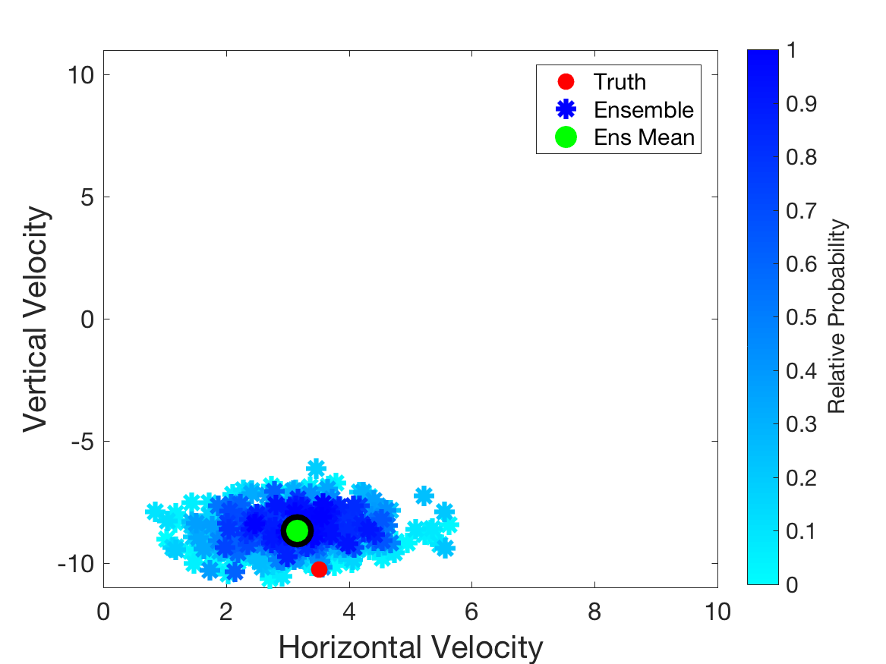
Data Assimilation: What can it do?
Forecast of velocity as lead time decreases.
As more observations are used, forecast for time 2 seconds generally improves, gets more certain.
After 1st Observation

Slide 37
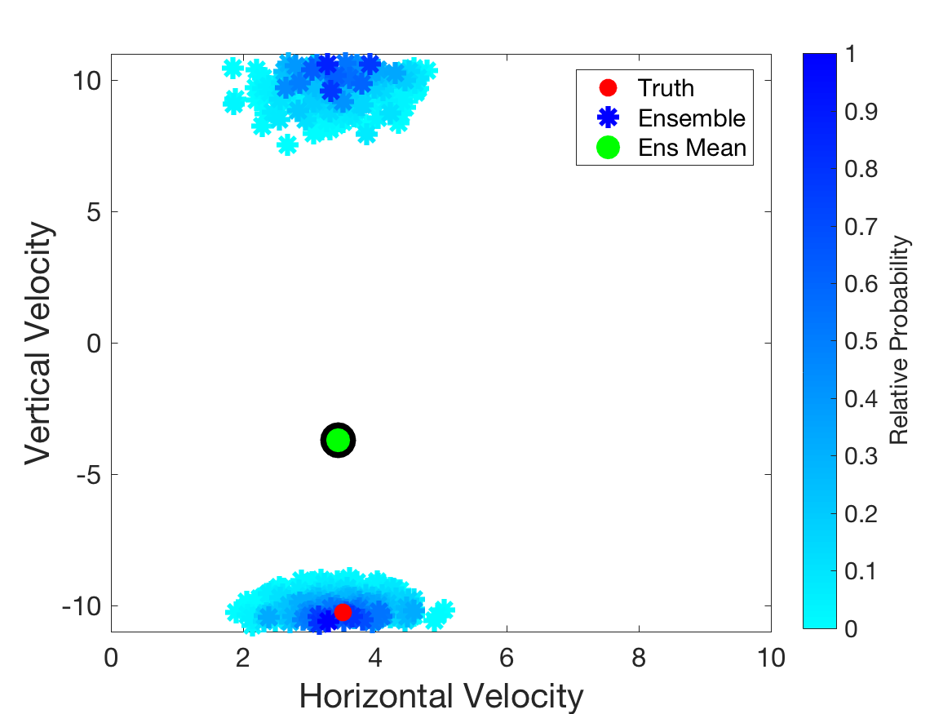
Data Assimilation: What can it do?
Forecast of velocity as lead time decreases.
As more observations are used, forecast for time 2 seconds generally improves, gets more certain.
After 2nd Observation

Slide 38
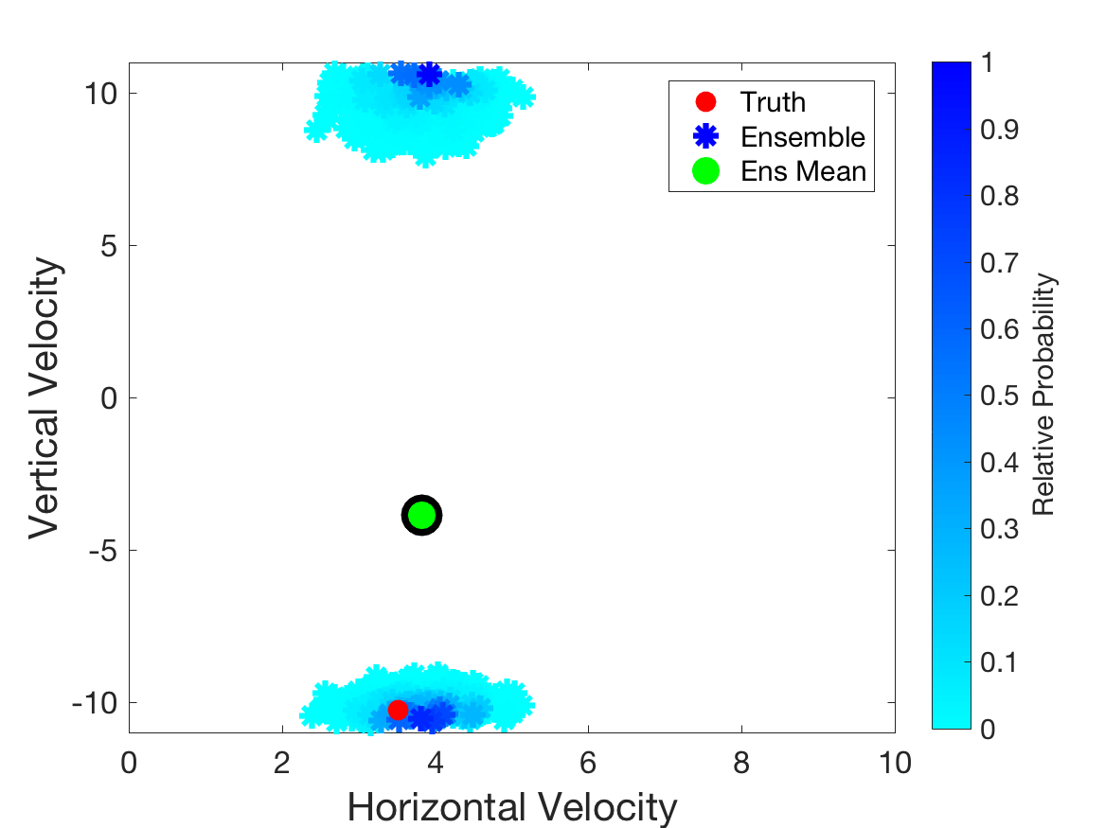
Data Assimilation: What can it do?
Forecast of velocity as lead time decreases.
As more observations are used, forecast for time 2 seconds generally improves, gets more certain.
After 3rd Observation

Slide 39
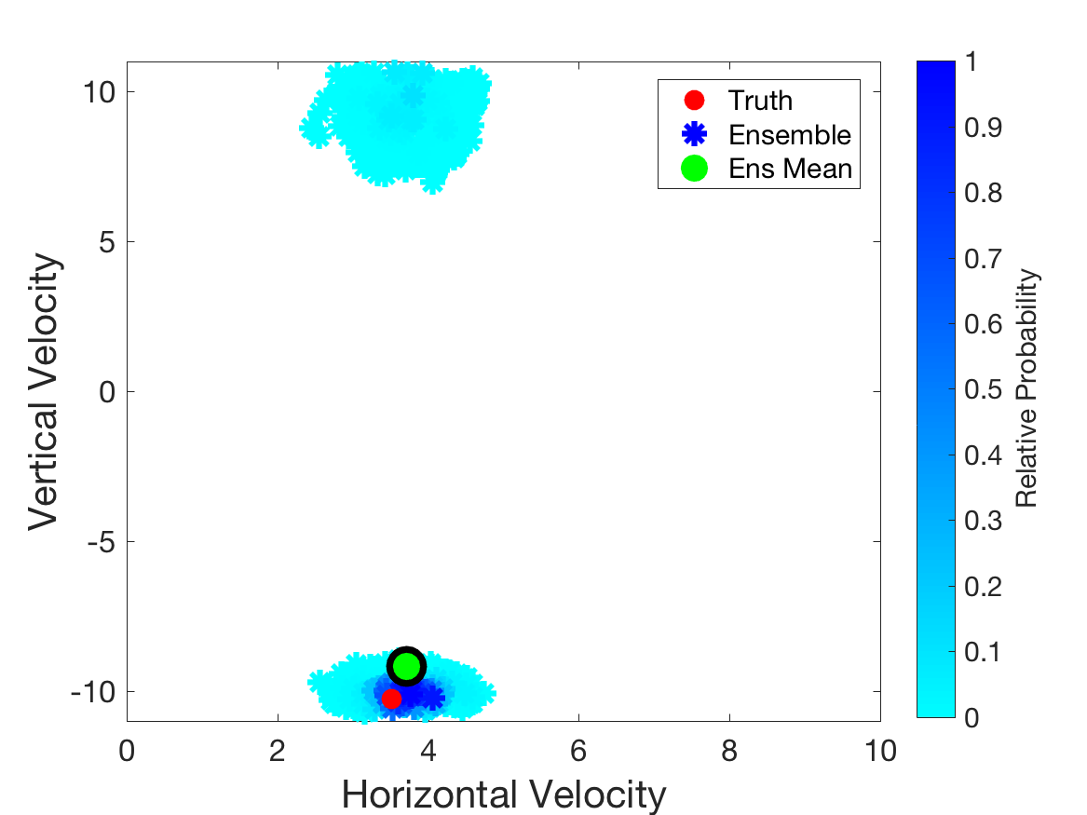
Data Assimilation: What can it do?
Forecast of velocity as lead time decreases.
As more observations are used, forecast for time 2 seconds generally improves, gets more certain.
After 4th Observation

Slide 40
Data Assimilation: What can it do?
Estimating initial conditions.
Example: estimate of shoulder position.

Slide 41
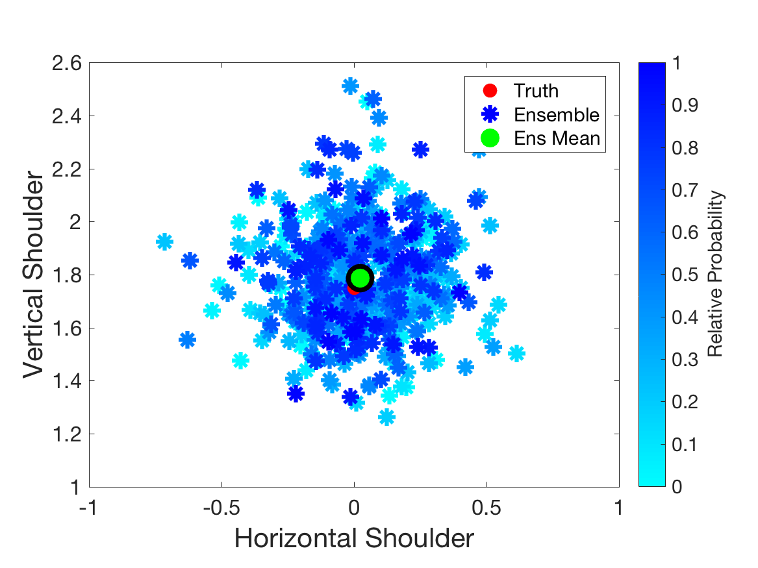
Data Assimilation: What can it do?
Estimating initial conditions: Shoulder position.
Estimate improves, gets more certain with more observations.
After 1st Observation

Slide 42
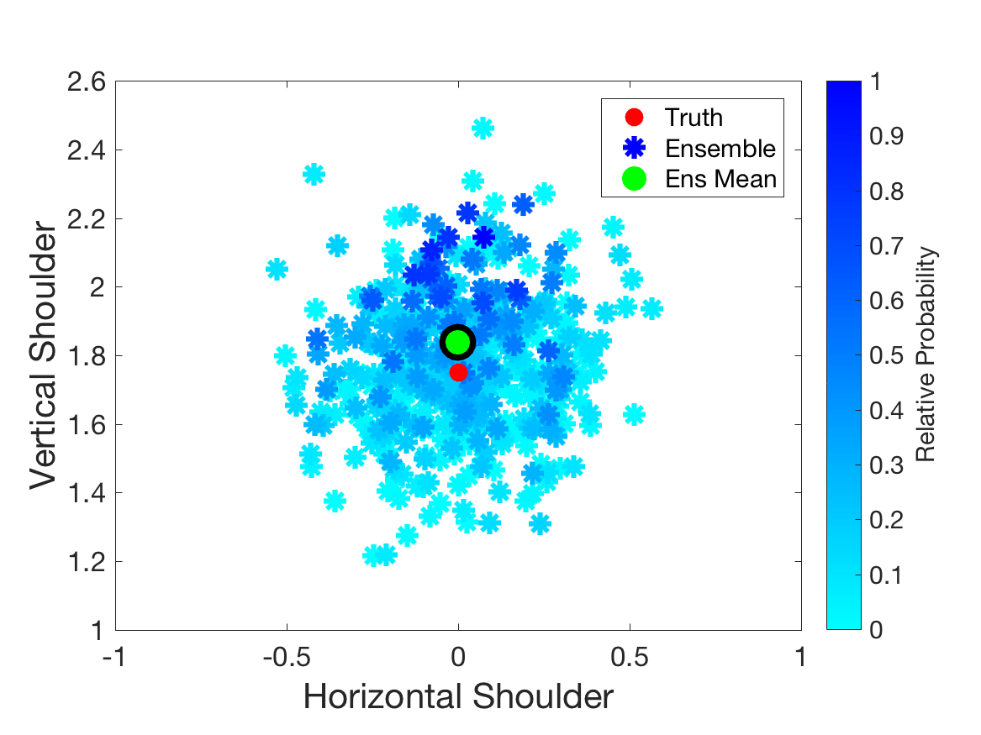
Data Assimilation: What can it do?
Estimating initial conditions: Shoulder position.
Estimate improves, gets more certain with more observations.
After 2nd Observation

Slide 43
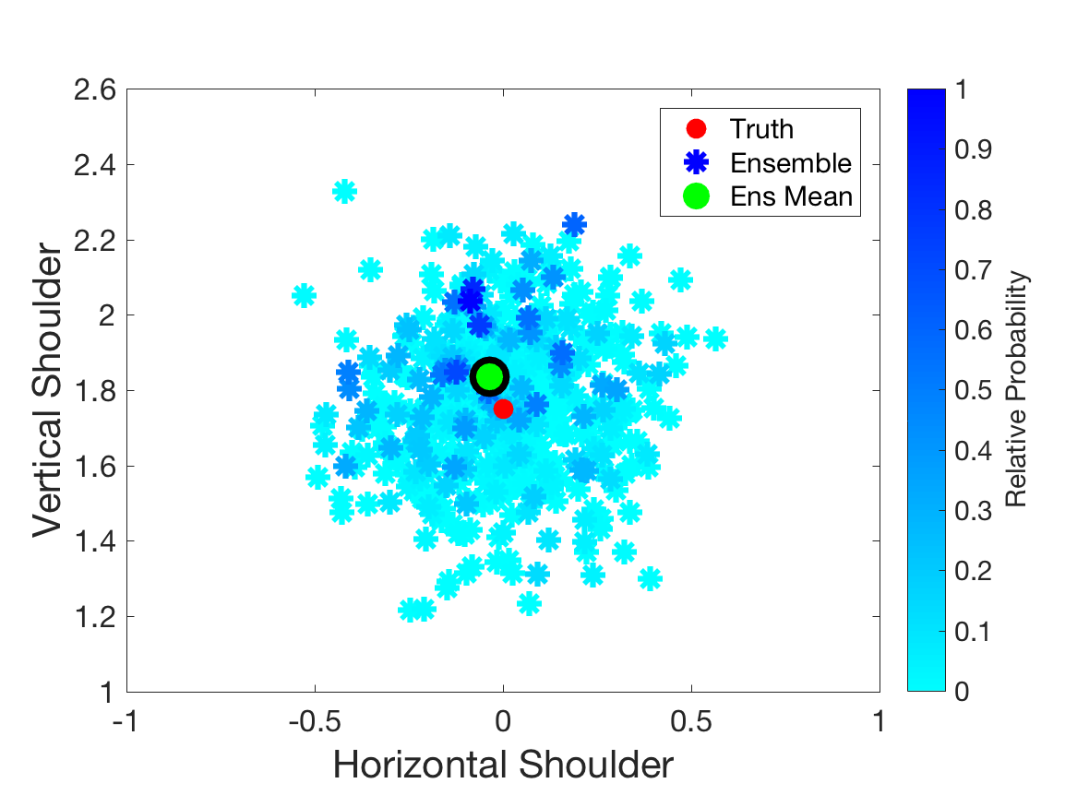
Data Assimilation: What can it do?
Estimating initial conditions: Shoulder position.
Estimate improves, gets more certain with more observations.
After 3rd Observation

Slide 44
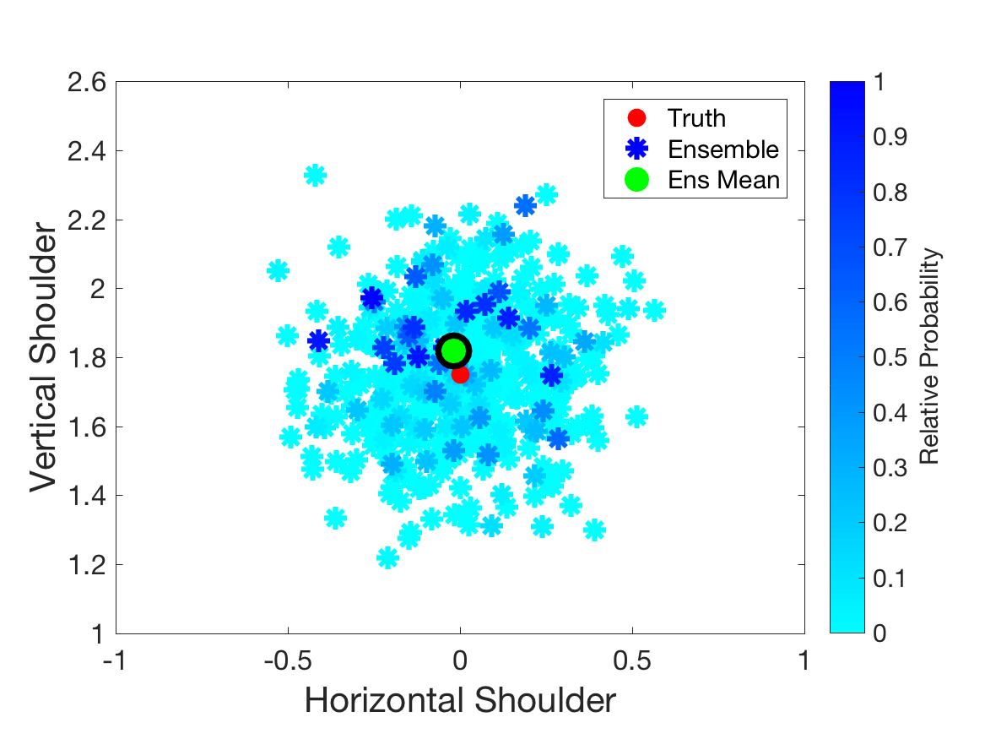
Data Assimilation: What can it do?
Estimating initial conditions: Shoulder position.
Estimate improves, gets more certain with more observations.
After 4th Observation

Slide 45
Data Assimilation: What can it do?
Estimating a model parameter:
Suppose we don’t know g exactly.
Put a sample of possible g values into model ensemble.
Each forecast has its own g.
Look at probability of resulting trajectories as function of g.
Display 500 highest probability trajectories out of 10,000.

Slide 46
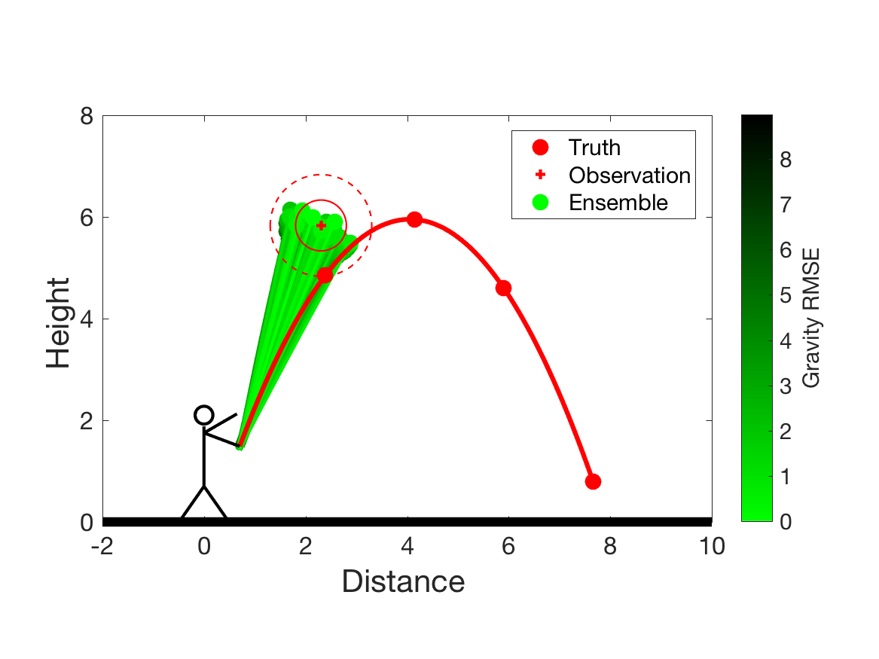
Data Assimilation: What can it do?
Estimating model parameter: gravity.
Estimate improves, gets more certain with more observations.
After 1st Observation
Brighter green is closer to -9.8 m/s²

Slide 47
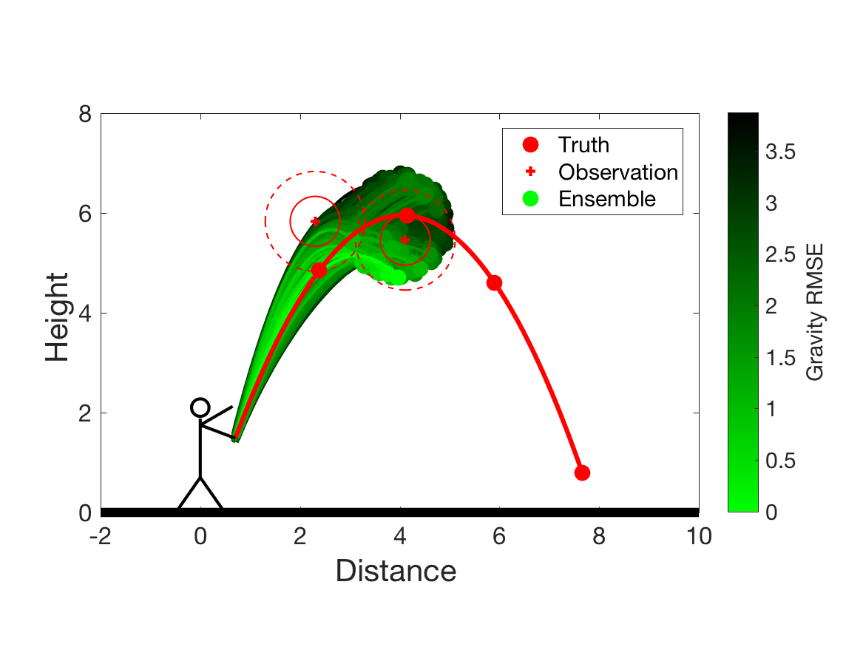
Data Assimilation: What can it do?
Estimating model parameter: gravity.
Estimate improves, gets more certain with more observations.
After 2nd Observation
Brighter green is closer to -9.8 m/s²

Slide 48
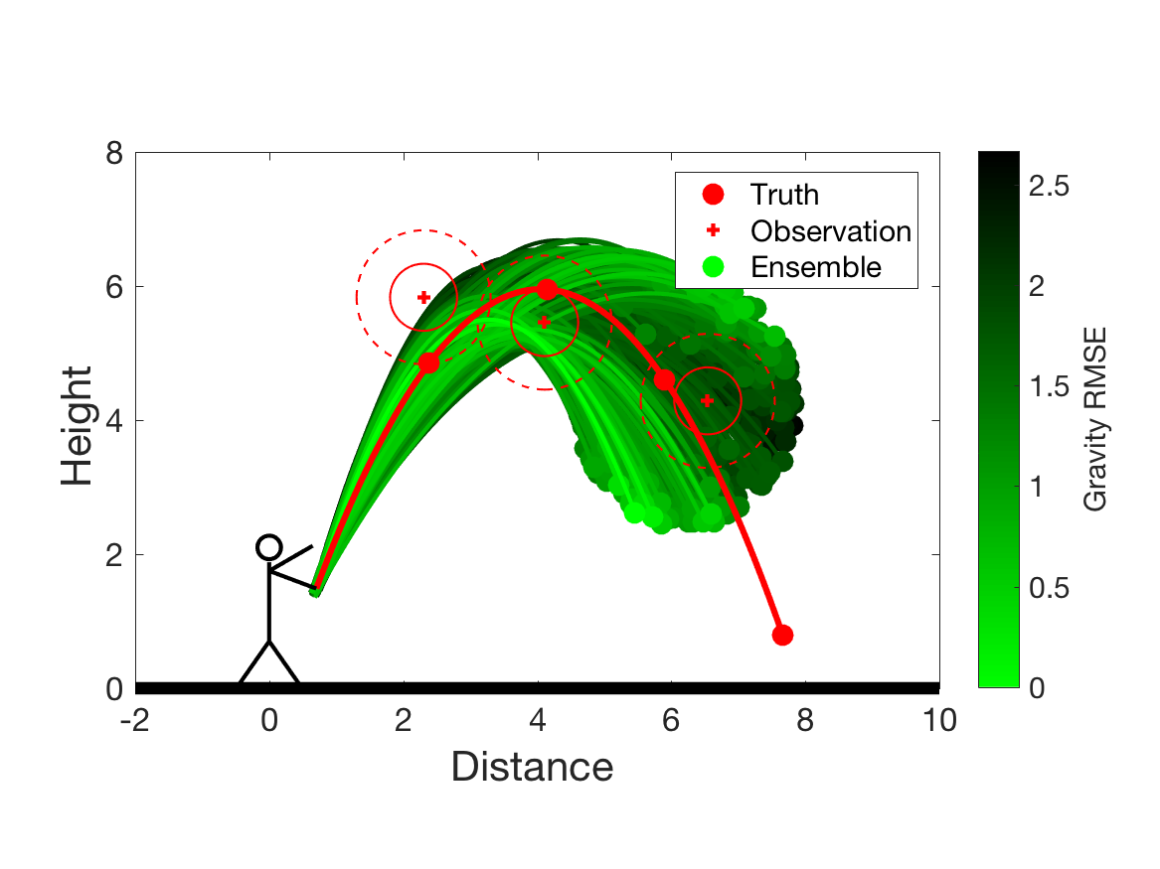
Data Assimilation: What can it do?
Estimating model parameter: gravity.
Estimate improves, gets more certain with more observations.
After 3rd Observation
Brighter green is closer to -9.8 m/s²

Slide 49
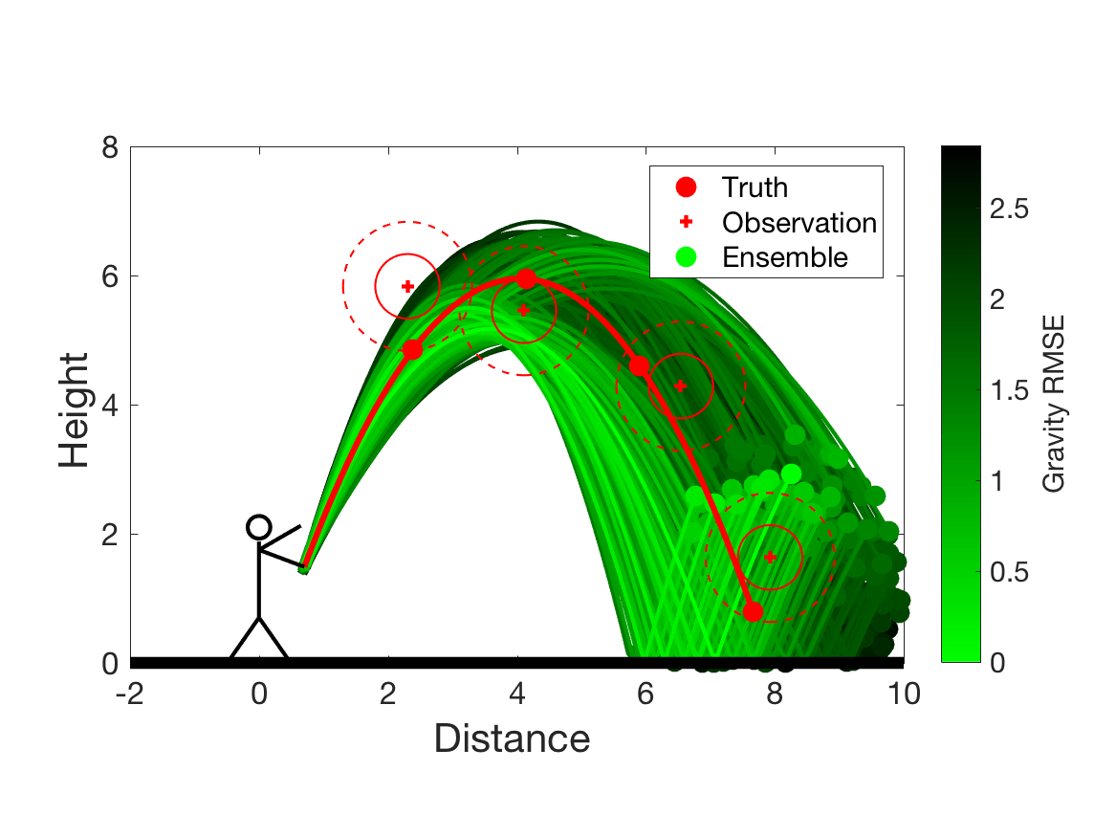
Data Assimilation: What can it do?
Estimating model parameter: gravity.
Estimate improves, gets more certain with more observations.
After 4th Observation
Brighter green is closer to -9.8 m/s²

Slide 50
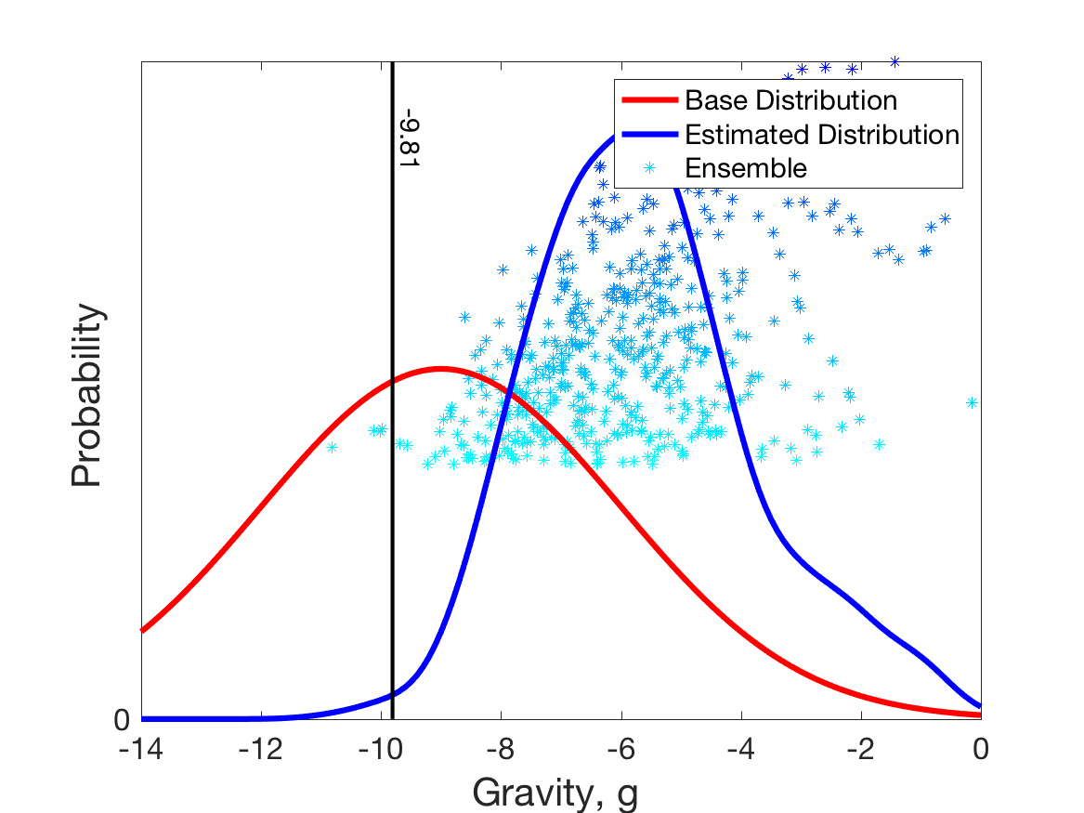
Data Assimilation: What can it do?
Estimating model parameter: gravity.
Estimate improves, gets more certain with more observations.
After 1st Observation

Slide 51
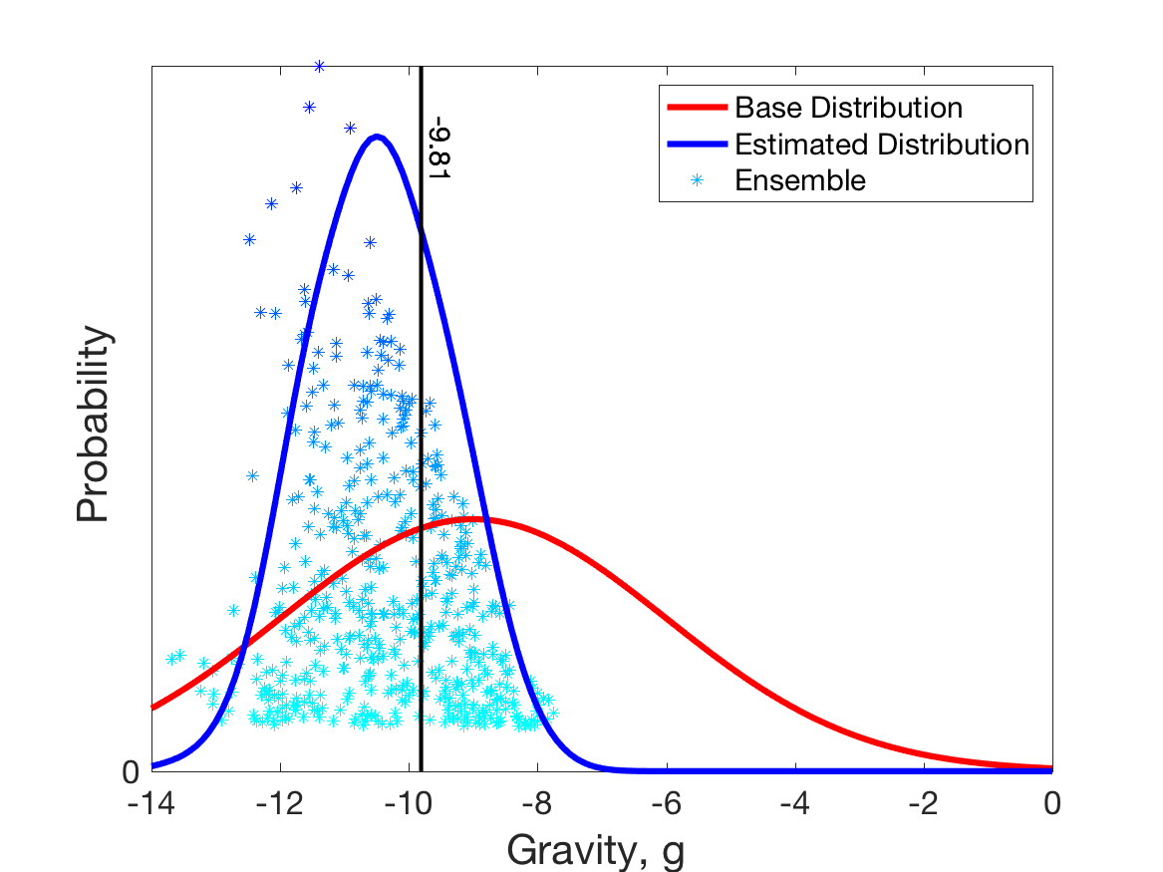
Data Assimilation: What can it do?
Estimating model parameter: gravity.
Estimate improves, gets more certain with more observations.
After 2nd Observation

Slide 52
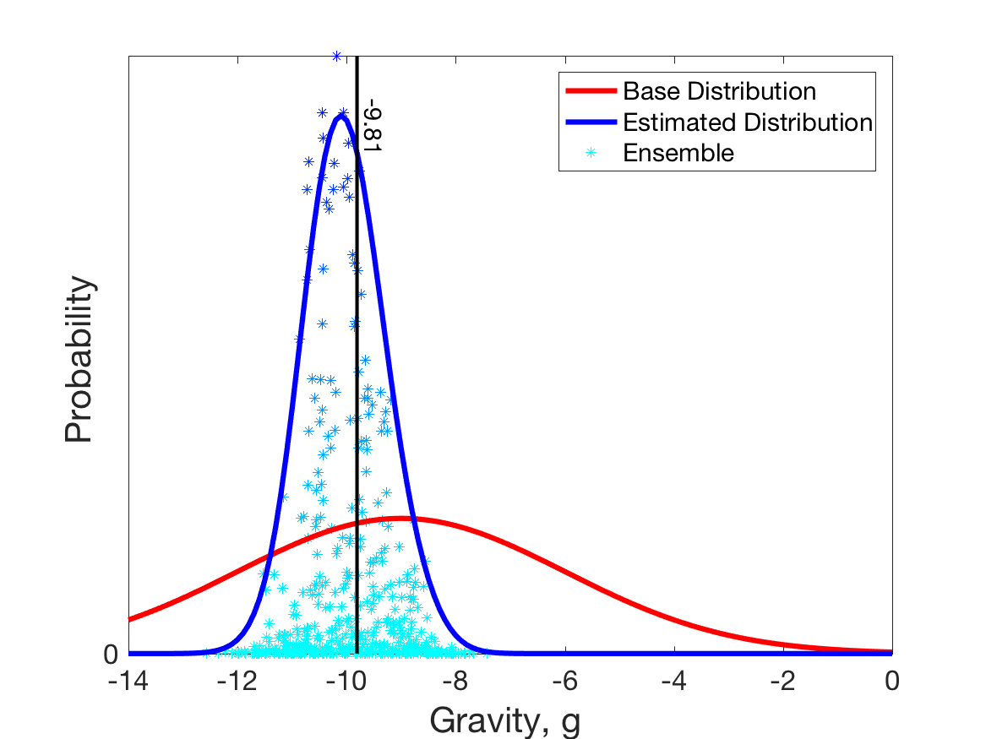
Data Assimilation: What can it do?
Estimating model parameter: gravity.
Estimate improves, gets more certain with more observations.
After 3rd Observation

Slide 53
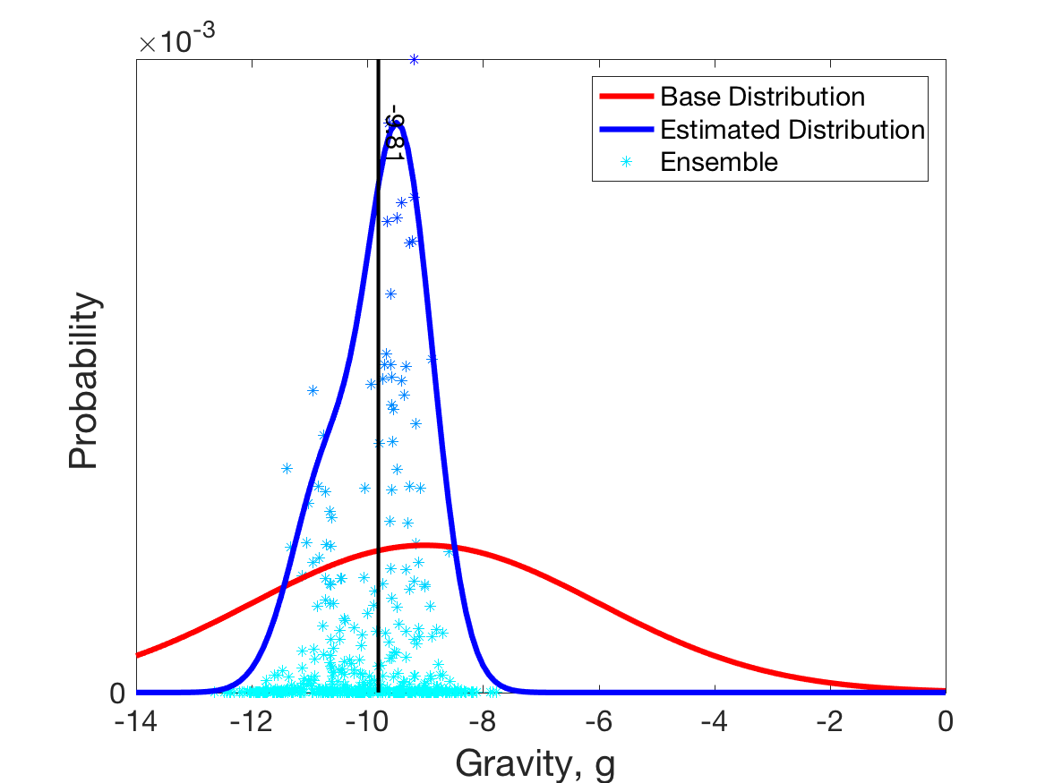
Data Assimilation: What can it do?
Estimating model parameter: gravity.
Estimate improves, gets more certain with more observations.
After 4th Observation

Slide 54
Data Assimilation: What can it do?
Learning about the model:
Is the model estimate of uncertainty accurate?
What is bias (mean error) of model forecasts?

Slide 55
Data Assimilation: What can it do?
Learning about the observations:
What is observation error variance?
What is bias (mean error) of observations?
How valuable is each observation?
Designing observation system:
Better to observe u and v?
Two observations at time 1, none at time 2?
One good instrument or two bad ones?

Slide 56
Data Assimilation: What can it do?
Learning about the ’external forcing’:
Example: Suppose there is a strong wind blowing.
We don’t have a (dynamical) forecast model for the wind.
Wind has strong influence on trajectory.
Can estimate wind from observations of ball.
Geophysical examples:
Soil moisture model forced by precipitation.
Atmosphere model forced by sea surface temperature.
Upper atmosphere forced by solar inputs.

Slide 57
Data Assimilation: What can it do?
Analyses and forecasts of state variables.
Smoothing estimates of state variables.
Estimate model parameters.
Estimate initial conditions.
Estimate model errors.
Estimate observing system errors.
Quantitatively design observing systems.
Estimate external forcing.
Estimate anything correlated with model/observations.

Slide 58
Outline
Data Assimilation: Building a simple forecast system.
Data Assimilation: What can it do?
Data Assimilaton: A general description.
Methods: Particle filter.
Methods: Variational.
Methods: Kalman filter.
Methods: Ensemble Kalman filter.
Additional topics.

Slide 59
Data Assimilation: A general description.
Ball example is in a 2-dimensional space, easy to visualize.
Really a 4-dimensional ‘phase’ space including velocity: u, v.
Atmosphere, ocean, land, coupled models are BIG.
But, still just a ‘ball’ moving in a HUGE phase space.
All data assimilation capabilities will still work.
Notes:
s01f01.eps

Slide 60
Data Assimilation: A general description.
A time-varying state-vector $x_{t}$,
Notes:
s01f01.eps

Slide 61
Data Assimilation: A general description.
A time-varying state-vector $x_{t}$,
Times $t_{k}$ with observations: $k=1, 2, …; t_{k+1}>t_{k}≥t_{0}$,
Notes:
s01f01.eps

Slide 62
Data Assimilation: A general description.
A time-varying state-vector $x_{t}$,
Times $t_{k}$ with observations: $k=1, 2, …; t_{k+1}>t_{k}≥t_{0}$,
Observations at $t_{k}$ related to $x_{t_{k}};$ $y_{k}=h_{k}\left(x_{t_{k}}\right)+ν_{k}$, (1)
Observations
Observation
Error
Forward
Operator
Notes:
s01f01.eps

Slide 63
Data Assimilation: A general description.
A time-varying state-vector $x_{t}$,
Times $t_{k}$ with observations: $k=1, 2, …; t_{k+1}>t_{k}≥t_{0}$,
Observations at $t_{k}$ related to $x_{t_{k}};$ $y_{k}=h_{k}\left(x_{t_{k}}\right)+ν_{k}$, (1)
Observation error is zero mean, normal, $ν_{k}=N\left(0,R_{k}\right)$, (2)
Observation
Error Covariance
Notes:
s01f01.eps

Slide 64
Data Assimilation: A general description.
A time-varying state-vector $x_{t}$,
Times $t_{k}$ with observations: $k=1, 2, …; t_{k+1}>t_{k}≥t_{0}$,
Observations at $t_{k}$ related to $x_{t_{k}}$; $y_{k}=h_{k}\left(x_{t_{k}}\right)+ν_{k}$, (1)
Observation error is zero mean, normal, $ν_{k}=N\left(0,R_{k}\right)$, (2)
A forecast model $m$ for the state-vector; $x_{t_{k+1}}=m_{k:k+1}\left(x_{t_{k}}\right)$ (3)
Notes:
s01f01.eps

Slide 65
Data Assimilation: A general description.
A time-varying state-vector $x_{t}$,
Times $t_{k}$ with observations: $k=1, 2, …; t_{k+1}>t_{k}≥t_{0}$,
Observations at $t_{k}$ related to $x_{t_{k}}$; $y_{k}=h_{k}\left(x_{t_{k}}\right)+ν_{k}$, (1)
Observation error is zero mean, normal, $ν_{k}=N\left(0,R_{k}\right)$, (2)
A forecast model $m$ for the state-vector; $x_{t_{k+1}}=m_{k:k+1}\left(x_{t_{k}}\right)$ (3)
$m$ can have deterministic and stochastic parts;
$m_{k:k+1}\left(x_{t_{k}}\right)=f_{k:k+1}\left(x_{t_{k}}\right)+g_{k:k+1}\left(x_{t_{k}}\right)$. (4)
Notes:
s01f01.eps

Slide 66
Data Assimilation: A general description.
Define the set of all observations taken no later than time $t_{k}$:
$Y_{t_{k}}=\left\{y_{t};t≤t_{k}\right\}$ (5)
Problems of interest are:
Analysis: $P\left(x_{t}|Y_{t_{k}}\right){, t=t}_{k}$ (6)
Forecast: $P\left(x_{t}|Y_{t_{k}}\right){, t>t}_{k}$ (7)
Smoother: $P\left(x_{t}|Y_{t_{k}}\right){, t<t}_{k}$ (8)
Notes:
s01f01.eps

Slide 67
Data Assimilation: A general description.
Define the set of all observations taken no later than time $t_{k}$:
$Y_{t_{k}}=\left\{y_{t};t≤t_{k}\right\}$ (5)
Problems of interest are:
Analysis: $P\left(x_{t}|Y_{t_{k}}\right){, t=t}_{k}$ (6)
Forecast: $P\left(x_{t}|Y_{t_{k}}\right){, t>t}_{k}$ (7)
Smoother: $P\left(x_{t}|Y_{t_{k}}\right){, t<t}_{k}$ (8)
Note: could also replace $x_{t}$ with any of the other things data
assimilation can estimate: parameters, initial conditions, …
Notes:
s01f01.eps

Slide 68
Data Assimilation: A general description.
Forecasts of state, $x$ are obtained from model.
Need to update forecast state given new observations:
$$P\left(x_{t_{k}}|Y_{t_{k}}\right)=P\left(x_{t_{k}}|y_{k},Y_{t_{k−1}}\right)$$
Bayes’ rule:
$$P\left(x_{t_{k}}|Y_{t_{k}}\right)=\frac{P\left(y_{k}|x_{t_{k}},Y_{t_{k−1}}\right)P\left(x_{t_{k}}|Y_{t_{k−1}}\right)}{P\left(y_{k}|Y_{t_{k−1}}\right)}$$
Observation errors uncorrelated in time:
$$P\left(y_{k}|x_{t_{k}},Y_{t_{k−1}}\right)=P\left(y_{k}|x_{t_{k}}\right)$$
Denominator in (9) is normalization, makes update a pdf.
(9)

Slide 69
Data Assimilation: A general description.
Probability after new observation:
Prior (forecast)
Likelihood
(10)
Posterior (analysis).
$$P\left(x_{t_{k}}|Y_{t_{k}}\right)=\frac{P\left(y_{k}|x\right)P\left(x_{t_{k}}|Y_{t_{k−1}}\right)}{Normalization}$$

Slide 70
Data Assimilation: A general description.
Probability after new observation:
Prior (forecast)
Likelihood
(10)
Posterior (analysis).
Forecasts produced by applying model to analysis.
Smoother can be derived from a similar Bayesian analysis.
$$P\left(x_{t_{k}}|Y_{t_{k}}\right)=\frac{P\left(y_{k}|x\right)P\left(x_{t_{k}}|Y_{t_{k−1}}\right)}{Normalization}$$

Slide 71
Data Assimilation: A general description.
Aside: Derivation of generalized Bayes:
$$P\left(A,B\right)= P\left(A | B\right) P\left(B\right) =P\left(B | A\right)P\left(A\right)$$
(a1)

Slide 72
Data Assimilation: A general description.
Aside: Derivation of generalized Bayes:
$$P\left(A,B\right)= P\left(A | B\right) P\left(B\right) =P\left(B | A\right)P\left(A\right)$$
$$P\left(A,B,C\right)= P\left(A,\left(B,C\right)\right)=P\left(A | B,C\right)P\left(B,C\right)$$
$$P\left(A,B,C\right)= P\left(B,\left(A,C\right)\right)=P\left(B | A,C\right)P\left(A,C\right)$$
(a1)
(a2)
(a3)
Extend (a1) to get (a2) and (a3).

Slide 73
Data Assimilation: A general description.
Aside: Derivation of generalized Bayes:
$$P\left(A,B\right)= P\left(A | B\right) P\left(B\right) =P\left(B | A\right)P\left(A\right)$$
$$P\left(A,B,C\right)= P\left(A,\left(B,C\right)\right)=P\left(A | B,C\right)P\left(B,C\right)$$
$$P\left(A,B,C\right)= P\left(B,\left(A,C\right)\right)=P\left(B | A,C\right)P\left(A,C\right)$$
$$P\left(A | B,C\right)=\frac{P\left(B | A,C\right)P\left(A,C\right)}{P\left(B,C\right)}$$
$$\frac{P\left(A,C\right)}{P\left(B,C\right)}=\frac{P\left(A | C\right)P\left(C\right)}{P\left(B | C\right)P\left(C\right)}=\frac{P\left(A | C\right)}{P\left(B | C\right)}$$
$$P\left(A | B,C\right)=\frac{P\left(B | A,C\right)P\left(A | C\right)}{P\left(B | C\right)}$$
(a1)
(a2)
(a3)
Solve from (a2), (a3).
(a4)
Ratio from (a1).
(a5)
Substitute (a4) in (a5).

Slide 74
Data Assimilation: A general description.
Aside: Derivation of generalized Bayes:
$$P\left(A | B,C\right) =\frac{P\left(B | A,C\right)P\left(A | C\right)}{P\left(B | C\right)}$$
$$P\left(x_{t_{k}}|{y_{k},Y}_{t_{k−1}}\right)=\frac{P\left(y_{k}|x_{t_{k}},Y_{t_{k−1}}\right)P\left(x_{t_{k}}|Y_{t_{k−1}}\right)}{P\left(y_{k}|Y_{t_{k−1}}\right)}$$

Slide 75
Data Assimilation: A general description.
Data Assimilation is stochastic.
Bayes can be used to define the problem.
General, but still some assumptions:
Observation error has zero mean.
Observation error is gaussian.
Observation error uncorrelated in time.

Slide 76
Outline
Data Assimilation: Building a simple forecast system.
Data Assimilation: What can it do?
Data Assimilaton: A general description.
Methods: Particle filter.
Methods: Variational.
Methods: Kalman filter.
Methods: Ensemble Kalman filter.
Additional topics.

Slide 77
The Data Assimilation Research Testbed (DART)
DART provides data assimilation ‘glue’ to build state-of-the-art ensemble forecast systems for even the largest models.
Prediction Model
Observing System
DART
Analysis

Slide 78
DART Goals
Provide State-of-the-Art Data Assimilation capability to:
Prediction research scientists,
Model developers,
Observation system developers,
Who may not have any assimilation expertise.

Slide 79
DART Design Constraints
Models small to huge.
Few or many observations.
Tiny to huge computational resources.
Entry cost must be low.
Competitive with existing methods for weather prediction:
Scientific quality of results,
Total computational effort.

Slide 80
Methods: Particle filter.
The method we have been using is too expensive.
Had to do 10,000 sample forecasts for this simple model.
This method scales horribly when the model size gets bigger.
Not practical for most geophysical applications.

Slide 81
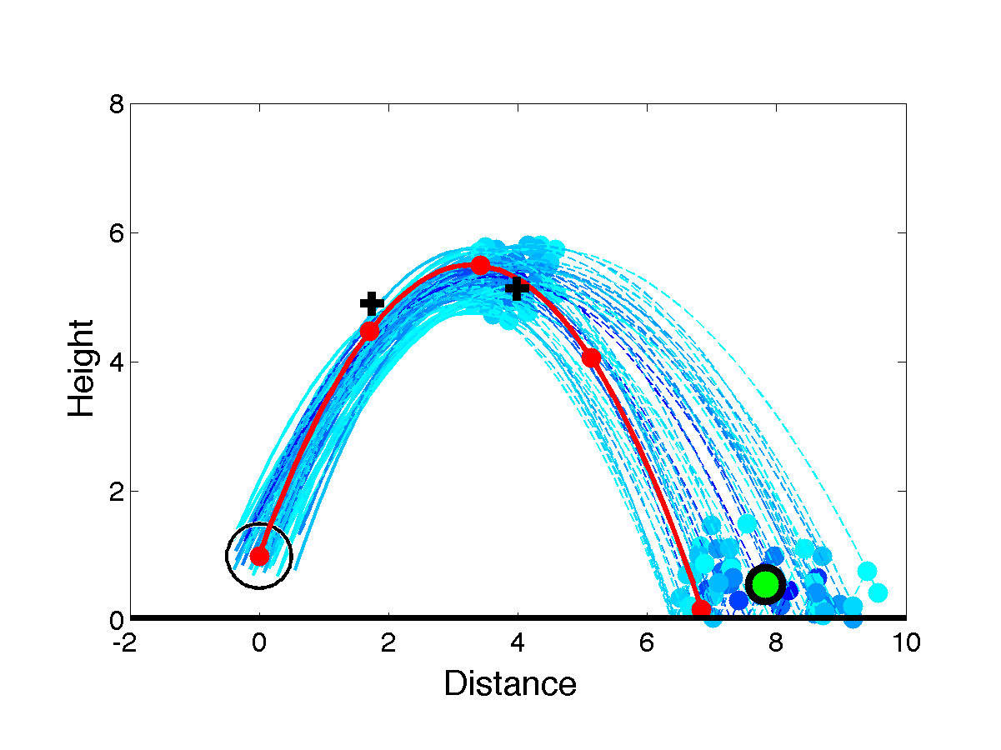
Methods: Particle filter.
The naïve method used here so far has:
Independent evolving estimates,
Associate probability with each estimate given observations.
Particle filter adds:
Periodically eliminate some unlikely estimates,
Duplicate likely estimates.

Slide 82
Methods: Particle filter.
Capabilities:
Can represent arbitrary probability distribution.
Trivial to implement.
Challenges:
Needs many model forecasts even for small models.
Scales poorly for large models.
Prospects:
Research on improving scaling underway.
Hybrid methods with ensemble filters promising.

Slide 83
Outline
Data Assimilation: Building a simple forecast system.
Data Assimilation: What can it do?
Data Assimilaton: A general description.
Methods: Particle filter.
Methods: Variational.
Methods: Kalman filter.
Methods: Ensemble Kalman filter.
Additional topics.

Slide 84
Methods: Variational
Simplify problem by only trying to find most likely trajectory.
This is the trajectory that maximizes the probability.
Same as trajectory that minimizes distance from observations.
(If the distance is normalized by observation error variances).

Slide 85
Methods: Variational
Find single most probable trajectory.
Maximize P:
$$P=\frac{1}{\sqrt{2π{σ_{1}}^{2}}}e^{\frac{−d_{1}^{2}}{2σ_{1}^{2}}}\frac{1}{\sqrt{2π{σ_{2}}^{2}}}e^{\frac{−d_{2}^{2}}{2σ_{2}^{2}}}\frac{1}{\sqrt{2π{σ_{3}}^{2}}}e^{\frac{−d_{3}^{2}}{2σ_{3}^{2}}}\frac{1}{\sqrt{2π{σ_{4}}^{2}}}e^{\frac{−d_{4}^{2}}{2σ_{4}^{2}}}$$

Slide 86
Methods: Variational
Maximize P:
$$P=\frac{1}{\sqrt{2π{σ_{1}}^{2}}}e^{\frac{−d_{1}^{2}}{2σ_{1}^{2}}}\frac{1}{\sqrt{2π{σ_{2}}^{2}}}e^{\frac{−d_{2}^{2}}{2σ_{2}^{2}}}\frac{1}{\sqrt{2π{σ_{3}}^{2}}}e^{\frac{−d_{3}^{2}}{2σ_{3}^{2}}}\frac{1}{\sqrt{2π{σ_{4}}^{2}}}e^{\frac{−d_{4}^{2}}{2σ_{4}^{2}}}$$
$\ln{P}$ will also have its maximum for this trajectory.
$−2ln{P}$ will have its minimum for this trajectory.
$$−2\ln{P}=−2\sum_{i=1}^{4}{\frac{1}{\sqrt{2πσ_{i}^{2}}}}+\sum_{i=1}^{4}{\frac{d_{i}^{2}}{σ_{i}^{2}}}$$
First term is constant, so minimize $\sum_{i=1}^{4}{\frac{d_{i}^{2}}{σ_{i}^{2}}}$

Slide 87
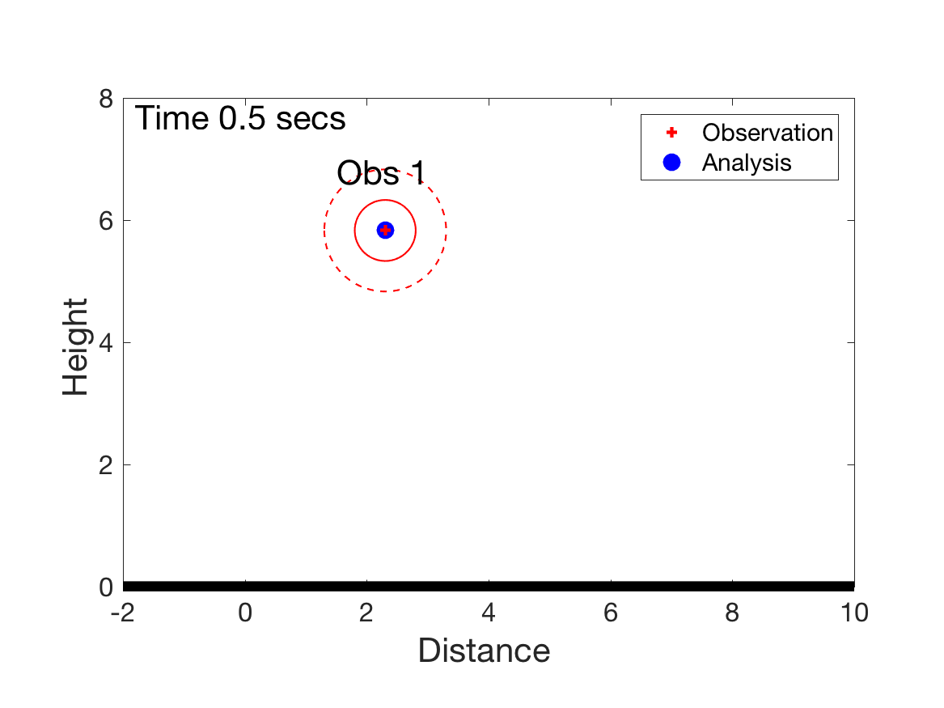
Methods: Variational
3D Variational assimilation.
Just consider observations at a single time.
Find state that minimizes distance to observations at this time.
For single x, y observation at time 0.5, solution is just the observation itself (not very exciting).

Slide 88
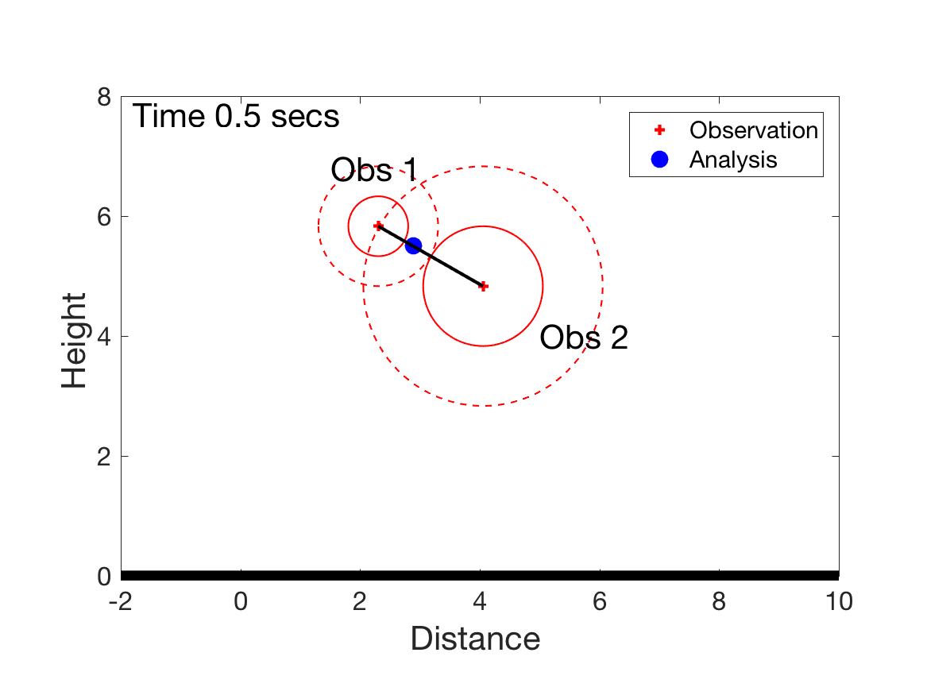
Methods: Variational
3D Variational assimilation.
Two observations of x, y at time 0.5.
One has error variance that is twice as large as the other.
Best analysis minimizes:
Where $σ^{2}$is observation error variance.
$${d_{1}^{2}}/{σ_{1}^{2}+{d_{2}^{2}}/{σ_{2}^{2}}}$$
d₁
d₂

Slide 89
Methods: Variational
3D Variational assimilation.
Cost function measures distance between a model state and the observations (normalized by the observation error).
Generalized cost function consistent with earlier equations.
Minimize J to get the analysis vector x_{a}
$$J\left(x_{a}\right)={\left[h\left(x_{a}\right)−y \right]}^{T}R^{−1}\left[h\left(x_{a}\right)−y \right]$$

Slide 90
Methods: Variational
Sequential Data Assimilation Framework
Prediction Model
Observing System
Observations
Forecasts
Initial
Conditions
Data Assimilation
Analysis

Slide 91
Methods: Variational
3D Variational is done sequentially.
Prediction Model
Observing System
Observations
Forecasts
Initial
Conditions
Data Assimilation
A forecast from a previous time is available at assimilation time.
Analysis

Slide 92
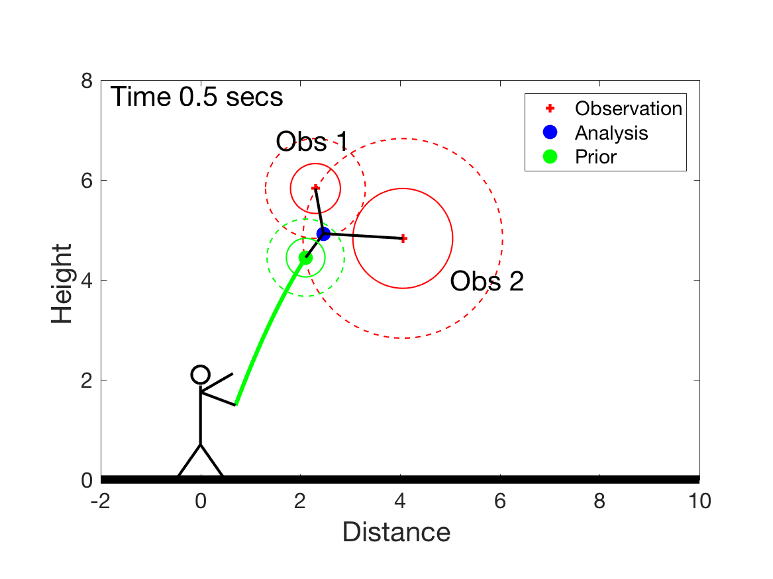
Methods: Variational
3D Variational assimilation.
Two observations of x, y at time 0.5.
Also have a forecast from an earlier time, prior called $x_{f}$.
Best analysis minimizes:
Challenge: What is
the ‘background error covariance’ (green circles)? In other words, how much do we trust the forecast compared to observations?
d₂
$${d_{1}^{2}}/{σ_{1}^{2}+{d_{2}^{2}}/{σ_{2}^{2}}+{d_{b}^{2}}/{σ_{b}^{2}}}$$
d₁
$$σ_{b}^{2}$$
d_{b}

Slide 93
Methods: Variational
3-Dimensional Variational Method:
Cost function measures distance between a model state, the observations, and a background (forecast) state.
Generalized cost function consistent with earlier equations.
Minimize J to get the analysis vector x_{a}
Challenge: What is background error covariance matrix, B?
$$J\left(x_{a}\right)={\left(x_{a}−x_{f}\right)}^{T}B^{−1}\left(x_{a}−x_{f}\right)+{\left[h\left(x_{a}\right)−y \right]}^{T}R^{−1}\left[h\left(x_{a}\right)−y \right]$$

Slide 94
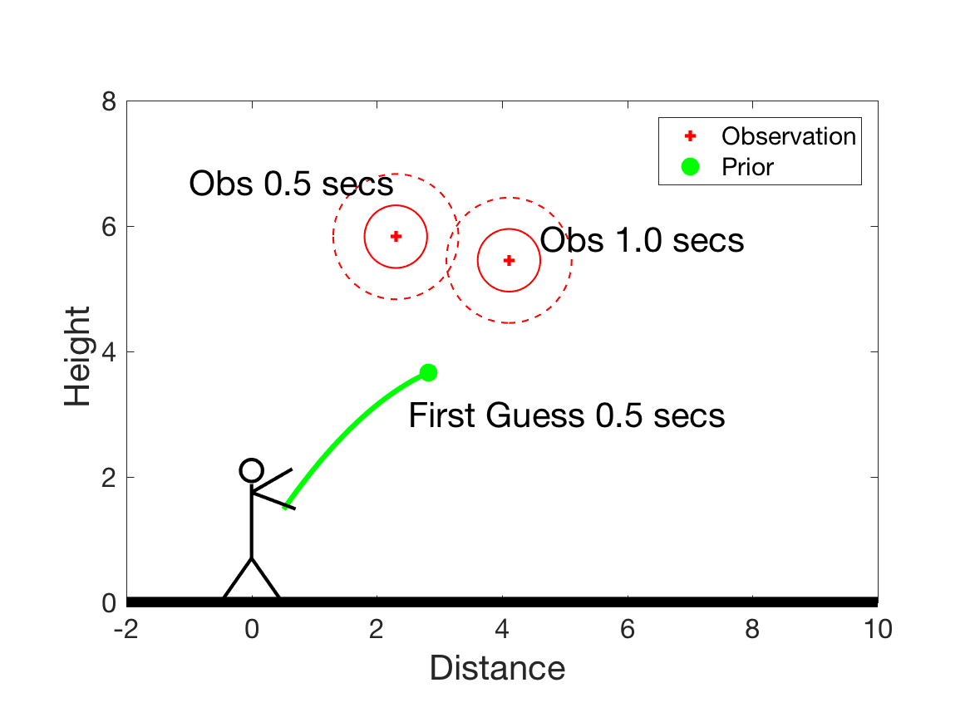
Methods: Variational
4D Variational assimilation.
Two observations of x, y at time 0.5 and 1.0.
Also have a forecast from an earlier time valid at time 0.5.

Slide 95
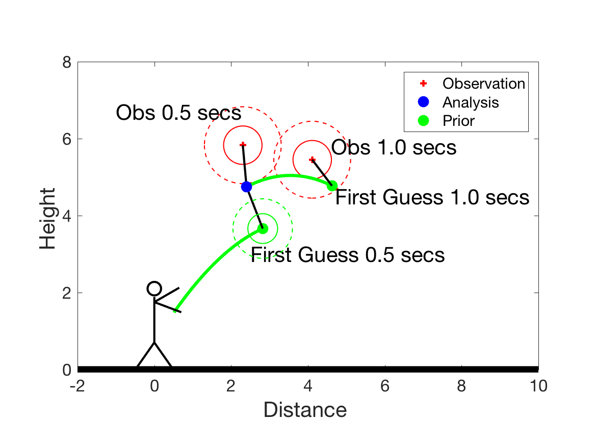
Methods: Variational
4D Variational assimilation.
Two observations of x, y at time 0.5 and 1.0.
Also have a forecast from an earlier time valid at time 0.5.
Find model state at time 0.5 that gives green forecast to time 1.0 and minimizes cost function:
d₁
d₂
d_{b}
$${d_{1}^{2}}/{σ_{1}^{2}+{d_{2}^{2}}/{σ_{2}^{2}}+{d_{b}^{2}}/{σ_{b}^{2}}}$$

Slide 96
Methods: Variational
4-Dimensional Variational Method:
Cost function measures distance between a model trajectory, the observations, and a background (forecast) state.
Generalized cost function consistent with earlier equations.
Minimize J to get the analysis vector x_{a}
$$J\left(x_{a}\right)={\left(x_{a}−x_{f}\right)}^{T}B^{−1}\left(x_{a}−x_{f}\right)+$$
$${\left[h_{1}\left(x_{a}\right)−y_{1}\right]}^{T}R_{1}^{−1}\left[h_{1}\left(x_{a}\right)−y_{1}\right]+$$
$${\left[h_{2}\left(m_{1:2}\left(x_{a}\right)\right)−y_{2}\right]}^{T}R_{2}^{−1}\left[h_{2}\left(m_{1:2}\left(x_{a}\right)\right)−y_{2}\right]$$
Background
1st time observations
2nd time observations

Slide 97
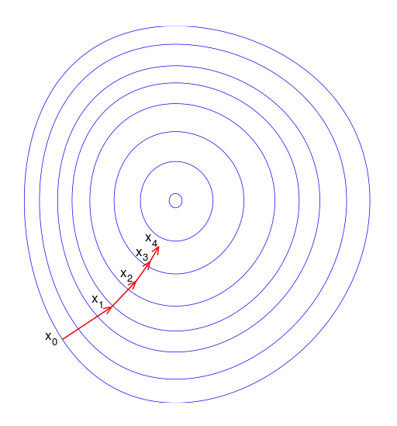
Methods: Variational
How to minimize these cost functions?
Standard gradient descent.
How to get the gradient for
large problems?
Must be very efficient.
There is a fast way
using linear tangent operator
of the model and its transpose
(or adjoint).
y
x

Slide 98
Methods: Variational
Gradient of J for 3D Variational:
Gradient of $J$ is:
$H$ is the Jacobian (called the tangent linear) of forward operator $h$.
The i^{th} row and j^{th} column of H is:
Where $h_{i}$ is the forward operator for the ith observation and $x_{j}$ is the j^{th} component of the state vector.
The transpose $H^{T}$ is called the adjoint of $H$.
$$J\left(x_{a}\right)={\left(x_{a}−x_{f}\right)}^{T}B^{−1}\left(x_{a}−x_{f}\right)+{\left[h\left(x_{a}\right)−y \right]}^{T}R^{−1}\left[h\left(x_{a}\right)−y \right]$$
$$∇J\left(x_{a}\right)=2B^{−1}\left(x_{a}−x_{f}\right)+2H^{T}R^{−1}\left[h\left(x_{a}\right)−y\right]$$
$$H_{i,j}\left(x\right)=\frac{∂h_{i}}{∂x_{j}}$$

Slide 99
Methods: Variational
Gradient of J for 3D Variational:
Once the adjoint $H^{T}$ is computed, gradient is straightfoward.
In trivial example here, $h$ is linear:
$H$ is just matrix representation of $h$.
$$∇J\left(x_{a}\right)=2B^{−1}\left(x_{a}−x_{f}\right)+2H^{T}R^{−1}\left[h\left(x_{a}\right)−y\right]$$

Slide 100
Methods: Variational
Gradient of J for 4D Variational:
Gradient of first line is same as 3D Variational.
Last line leads to extra gradient term:
$$J\left(x_{a}\right)={\left(x_{a}−x_{f}\right)}^{T}B^{−1}\left(x_{a}−x_{f}\right)+{\left[h_{1}\left(x_{a}\right)−y_{1}\right]}^{T}R_{1}^{−1}\left[h_{1}\left(x_{a}\right)−y_{1}\right]+$$
$${\left[h_{2}\left(m_{1:2}\left(x_{a}\right)\right)−y_{2}\right]}^{T}R_{2}^{−1}\left[h_{2}\left(m_{1:2}\left(x_{a}\right)\right)−y_{2}\right]$$
$$2{M_{1:2}}^{T}H_{2}^{T}R_{2}^{−1}\left[h_{2}\left(m_{1:2}\left(x_{a}\right)\right)−y_{2}\right]$$

Slide 101
Methods: Variational
Gradient of J for 4D Variational:
Gradient of first line is same as 3D Variational.
Last line leads to extra gradient term:
$M_{1:2}$ is the linear tangent of the forecast model, $m_{1:2}$ . ${M_{1:2}}^{T}$ is the adjoint of the forecast model.
$J\left(x_{a}\right)={\left(x_{a}−x_{f}\right)}^{T}B^{−1}\left(x_{a}−x_{f}\right)+{\left[h_{1}\left(x_{a}\right)−y_{1}\right]}^{T}R_{1}^{−1}\left[h_{1}\left(x_{a}\right)−y_{1}\right]$+
$${\left[h_{2}\left(m_{1:2}\left(x_{a}\right)\right)−y_{2}\right]}^{T}R_{2}^{−1}\left[h_{2}\left(m_{1:2}\left(x_{a}\right)\right)−y_{2}\right]$$
$$2{M_{1:2}}^{T}H_{2}^{T}R_{2}^{−1}\left[h_{2}\left(m_{1:2}\left(x_{a}\right)\right)−y_{2}\right]$$

Slide 102
Methods: Variational
Ball example: state vector is $x,y,u,v$;
$$x≡\left\{x,y,u,v\right\}$$
$$x_{t+∆t}=x_{t}+u_{t}∆t$$
$$y_{t+∆t}=y_{t}+v_{t}∆t+0.5g{\left(∆t\right)}^{2}$$
$$u_{t+∆t}=u_{t}$$
$$v_{t+∆t}=v_{t}+g∆t$$
Model equations for one timestep advance.
$$x_{t+∆t}=m\left(x_{t}\right)$$
Tangent linear $\left[\frac{∂m_{i}}{∂x_{j}}\right]$
Adjoint
$$M=\left|\begin{matrix}1 & 0 & ∆t & 0 \\ 0 & 1 & 0 & ∆t \\ 0 & 0 & 1 & 0 \\ 0 & 0 & 0 & 1\end{matrix}\right|$$
$$M^{T}=\left|\begin{matrix}1 & 0 & 0 & 0 \\ 0 & 1 & 0 & 0 \\ ∆t & 0 & 1 & 0 \\ 0 & ∆t & 0 & 1\end{matrix}\right|$$

Slide 103
Methods: Variational
Enhancing performance and speed, 3D and 4D Variational:
Make B matrix smaller and better conditioned:
Transform model variables to minimize off-diagonal terms.
Transform to make some variables unimportant, truncate.
Incremental variational:
Minimize $J\left(δx\right)$where $δx=x_{a}−x_{f}$
Makes problem quadratic (like our ball example).
Size of $δx$ may be smaller than $x$ after transforms.

Slide 104
Methods: Variational
Enhancing performance and speed, 4D Variational:
Tangent linear is for a given nonlinear trajectory.
Increments from optimization may violate linear assumption.
Outer/inner loop:
After some number of gradient descent steps (inner loop), rerun nonlinear trajectory (outer loop).
Use reduced resolution/accuracy forecast model.
Lots of other cool numerical tricks and empirical accelerations.

Slide 105
Methods: Variational
Capabilities:
Estimate maximum likelihood solution only.
With enhancements works well for huge models.
Has been state-of-the-art for weather prediction.
Challenges:
Coding of tangent linear/adjoint can be time consuming.
Good convergence of optimization may be challenging.
Good B matrices may be hard to find.
Prospects:
Weak constraint 4Dvar allows for model error.
Hybrid methods with ensemble filters promising.

Slide 106
Outline
Data Assimilation: Building a simple forecast system.
Data Assimilation: What can it do?
Data Assimilaton: A general description.
Methods: Particle filter.
Methods: Variational.
Methods: Kalman filter.
Methods: Ensemble Kalman filter.
Additional topics.

Slide 107
Methods: Kalman Filter
Assumes:
linear model Gaussian noise
Gaussian state
linear forward operator
Gaussian observation error
$m_{k:k+1}\left(x_{t_{k}}\right)=f_{k:k+1}\left(x_{t_{k}}\right)+g_{k:k+1}\left(x_{t_{k}}\right)$.
$$y_{k}=h_{k}\left(x_{t_{k}}\right)+ν_{k}$$
Notes:
s01f01.eps

Slide 108
Methods: Kalman Filter
Product of d-dimensional normals (gaussians) with means $μ_{1}$ and $μ_{2}$ and covariance matrics $Σ_{1}$ and $Σ_{1}$ is normal.
$$N\left(μ_{1},Σ_{1}\right)N\left(μ_{2},Σ_{2}\right)=cN\left(μ,Σ\right)$$

Slide 109
Methods: Kalman Filter
Product of d-dimensional normals (gaussians) with means $μ_{1}$ and $μ_{2}$ and covariance matrics $Σ_{1}$ and $Σ_{1}$ is normal.
Covariance: $Σ={\left(Σ_{1}^{−1}+Σ_{2}^{−1}\right)}^{−1}$
Mean: $μ=Σ\left(Σ_{1}^{−1}μ_{1}+Σ_{2}^{−1}μ_{2}\right)$
$$N\left(μ_{1},Σ_{1}\right)N\left(μ_{2},Σ_{2}\right)=cN\left(μ,Σ\right)$$

Slide 110
Methods: Kalman Filter
Product of d-dimensional normals (gaussians) with means $μ_{1}$ and $μ_{2}$ and covariance matrics $Σ_{1}$ and $Σ_{1}$ is normal.
(11)
Covariance: $Σ={\left(Σ_{1}^{−1}+Σ_{2}^{−1}\right)}^{−1}$ (12)
Mean: $μ=Σ\left(Σ_{1}^{−1}μ_{1}+Σ_{2}^{−1}μ_{2}\right)$ (13)
Weight: $c=\frac{1}{{\left(2π\right)}^{d/2}{\left|Σ_{1}+Σ_{2}\right|}^{1/2}}exp\left\{−\frac{1}{2}\left[{\left(μ_{2}−μ_{1}\right)}^{T}{\left(Σ_{1}+Σ_{2}\right)}^{−1}\left(μ_{2}−μ_{1}\right)\right]\right\}$
$$N\left(μ_{1},Σ_{1}\right)N\left(μ_{2},Σ_{2}\right)=cN\left(μ,Σ\right)$$
We’ll ignore the weight since we immediately normalize products to be PDFs.

Slide 111
Methods: Kalman Filter
Recall our earlier assimilation update equation.
(10)
Numerator is just product of two gaussians.
Denominator just normalizes posterior to be a PDF.
$$P\left(x_{t_{k}}|Y_{t_{k}}\right)=\frac{P\left(y_{k}|x\right)P\left(x_{t_{k}}|Y_{t_{k−1}}\right)}{Normalization}$$

Slide 112
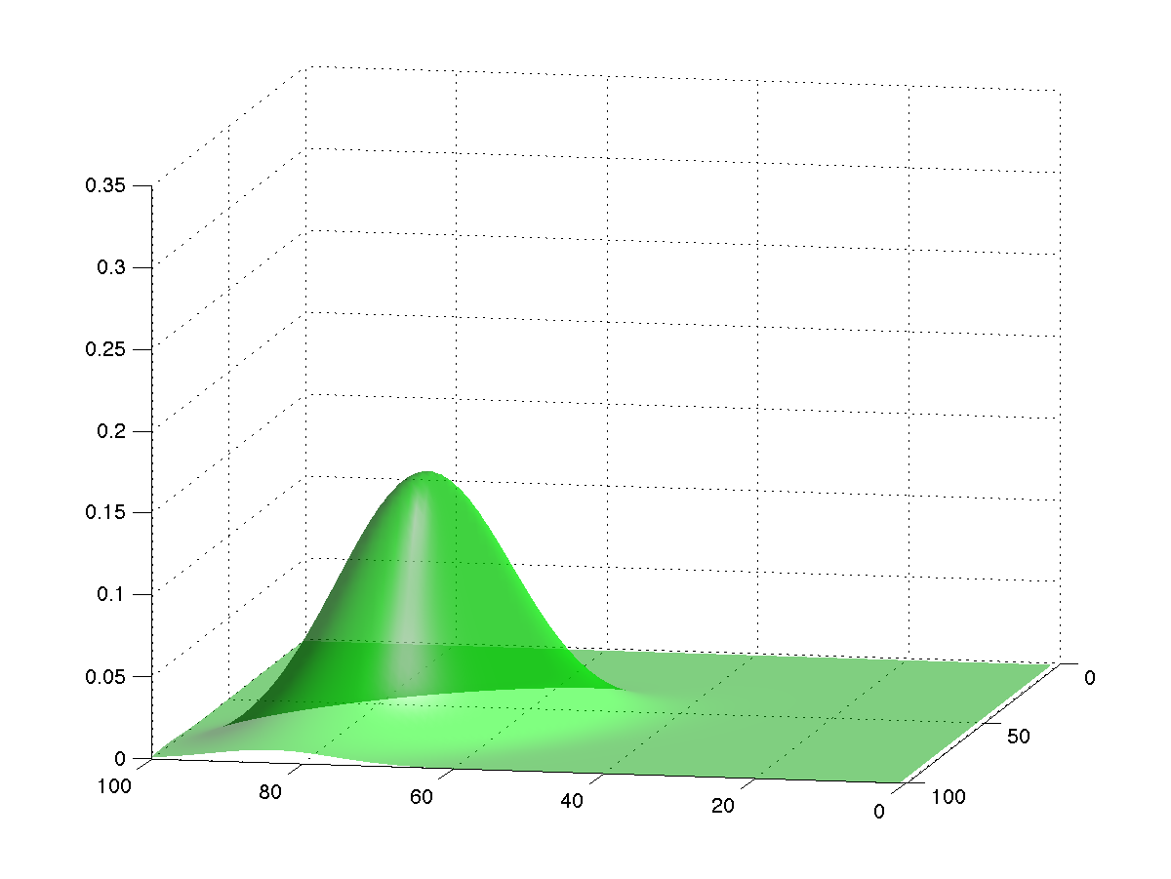
Methods: Kalman Filter
(10)
Prior is gaussian, comes from forecast model.
$$P\left(x_{t_{k}}|Y_{t_{k}}\right)=\frac{P\left(y_{k}|x\right)P\left(x_{t_{k}}|Y_{t_{k−1}}\right)}{Normalization}$$

Slide 113
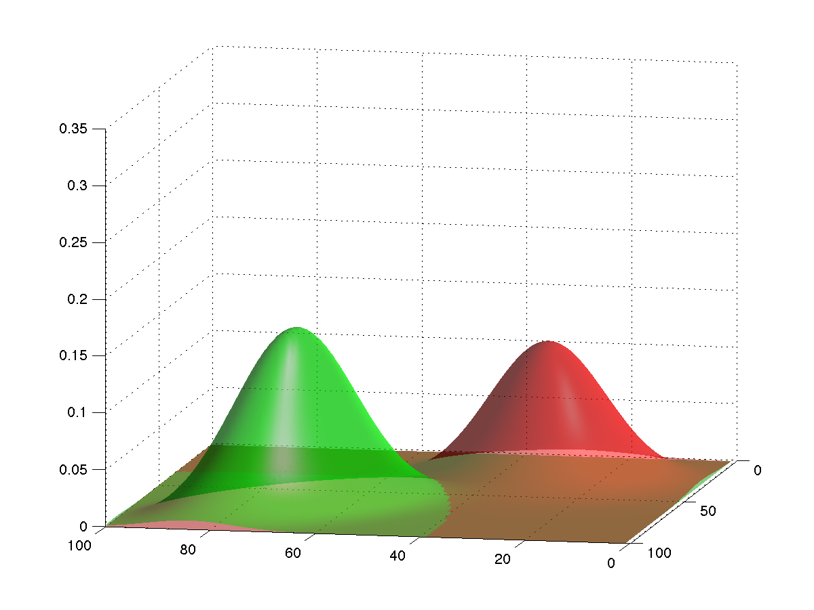
Methods: Kalman Filter
(10)
Likelihood gaussian: mean is measured, covariance from designer.
$$P\left(x_{t_{k}}|Y_{t_{k}}\right)=\frac{P\left(y_{k}|x\right)P\left(x_{t_{k}}|Y_{t_{k−1}}\right)}{Normalization}$$

Slide 114
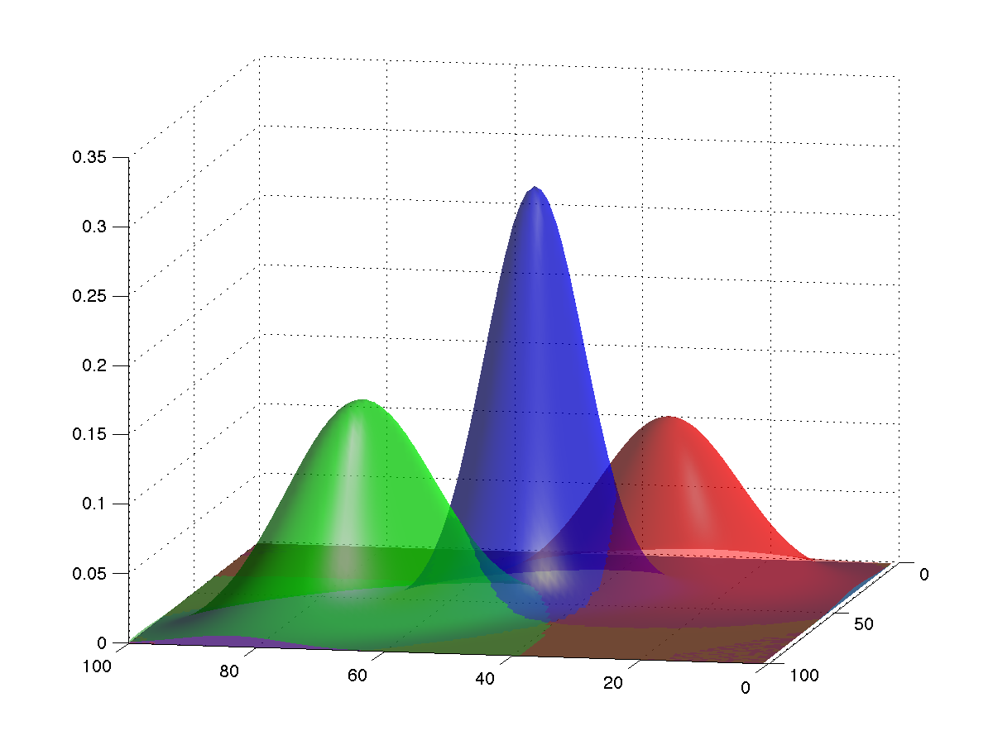
Methods: Kalman Filter
(10)
Posterior is gaussian, from (11).
$$P\left(x_{t_{k}}|Y_{t_{k}}\right)=\frac{P\left(y_{k}|x\right)P\left(x_{t_{k}}|Y_{t_{k−1}}\right)}{Normalization}$$

Slide 115
Methods: Kalman Filter
Kalman filter cost challenges:
Product of d-dimensional normals (gaussians) with means $μ_{1}$ and $μ_{2}$ and covariance matrics $Σ_{1}$ and $Σ_{1}$ is normal.
(11)
Covariance: $Σ={\left(Σ_{1}^{−1}+Σ_{2}^{−1}\right)}^{−1}$ (12)
Mean: $μ=Σ\left(Σ_{1}^{−1}μ_{1}+Σ_{2}^{−1}μ_{2}\right)$ (13)
Must store and invert covariance matrices.
Too big to store for large problems.
Too costly to invert, > O(n²).
$$N\left(μ_{1},Σ_{1}\right)N\left(μ_{2},Σ_{2}\right)=cN\left(μ,Σ\right)$$

Slide 116
Methods: Kalman Filter
Capabilities:
Estimates normal approximation to probability density.
Easy to apply with linear models.
Huge literature with many extensions.
Challenges:
Scales poorly for large models.
Requires extensions for use with nonlinear models or h.
Prospects:
Ensemble approximations avoid challenges.

Slide 117
Outline
Data Assimilation: Building a simple forecast system.
Data Assimilation: What can it do?
Data Assimilaton: A general description.
Methods: Particle filter.
Methods: Variational.
Methods: Kalman filter.
Methods: Ensemble Kalman filter.
Additional topics.

Slide 118
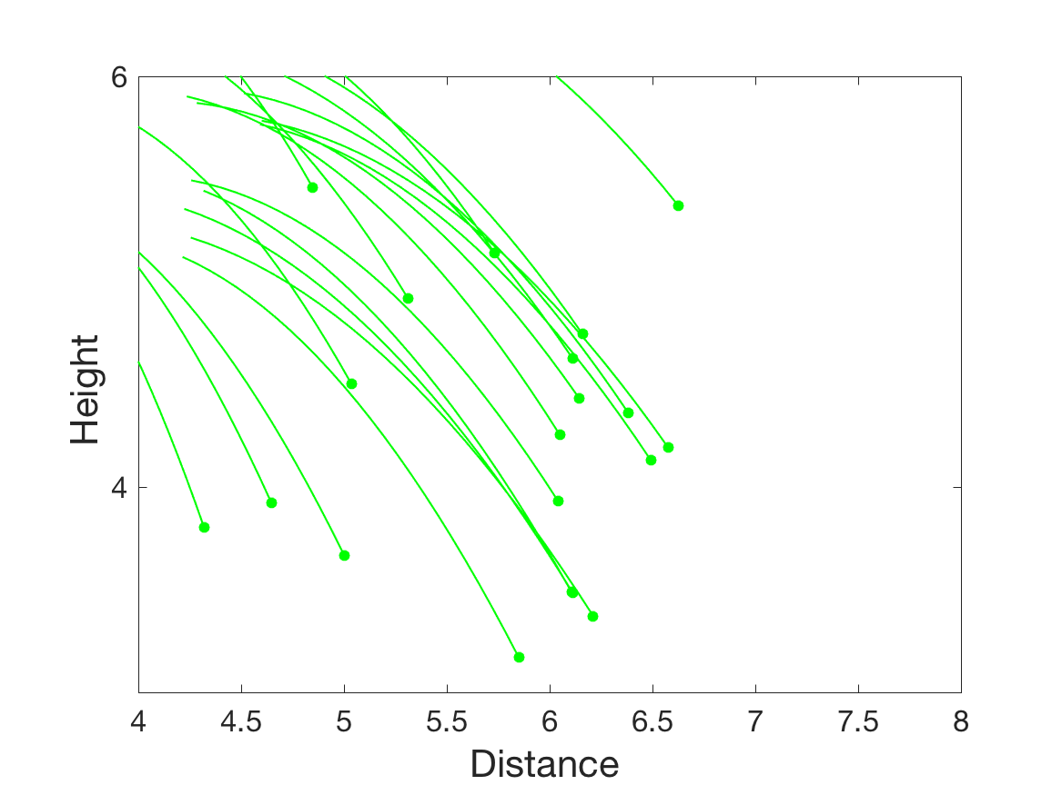
Methods: Ensemble Kalman Filter
Prior ensemble:

Slide 119
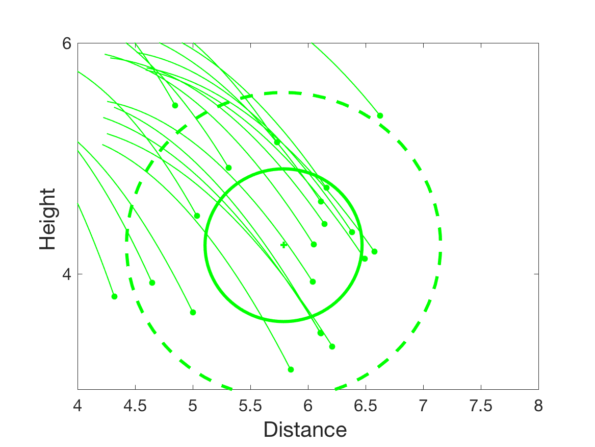
Methods: Ensemble Kalman Filter
Prior ensemble: fit a gaussian, sample mean and covariance (pdf is green contours).

Slide 120
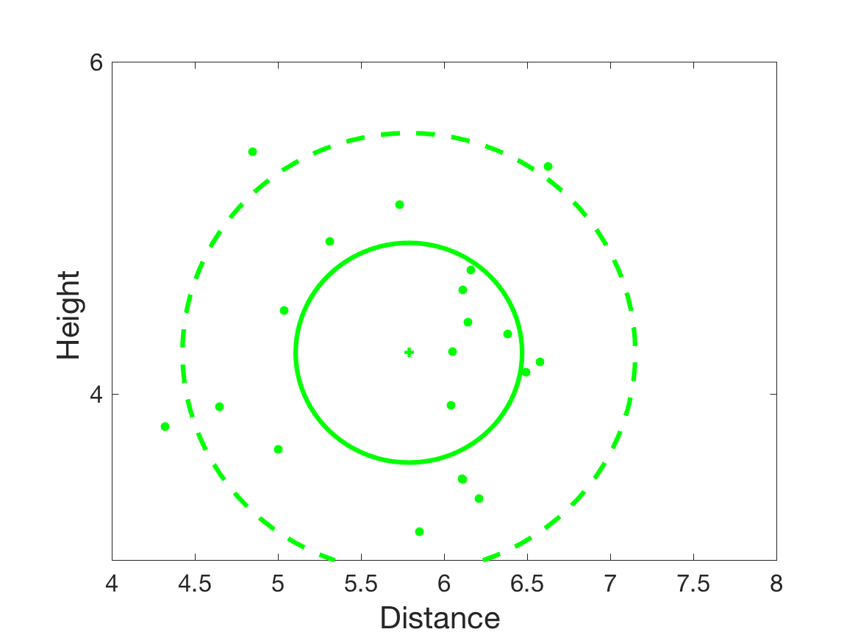
Methods: Ensemble Kalman Filter
Prior ensemble: fit a gaussian, sample mean and covariance (pdf is green contours).

Slide 121
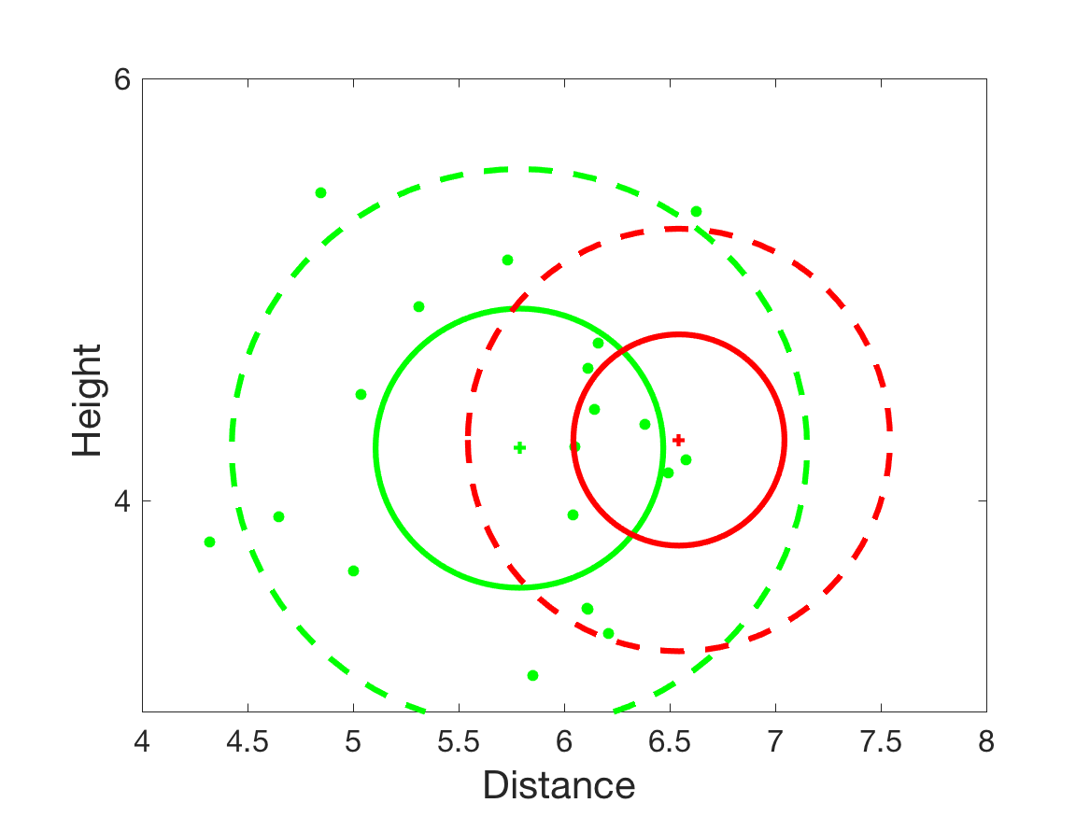
Methods: Ensemble Kalman Filter
Prior ensemble: fit a gaussian, sample mean and covariance (pdf is green contours).
Kalman filter product of observation likelihood (red) with prior (green)

Slide 122
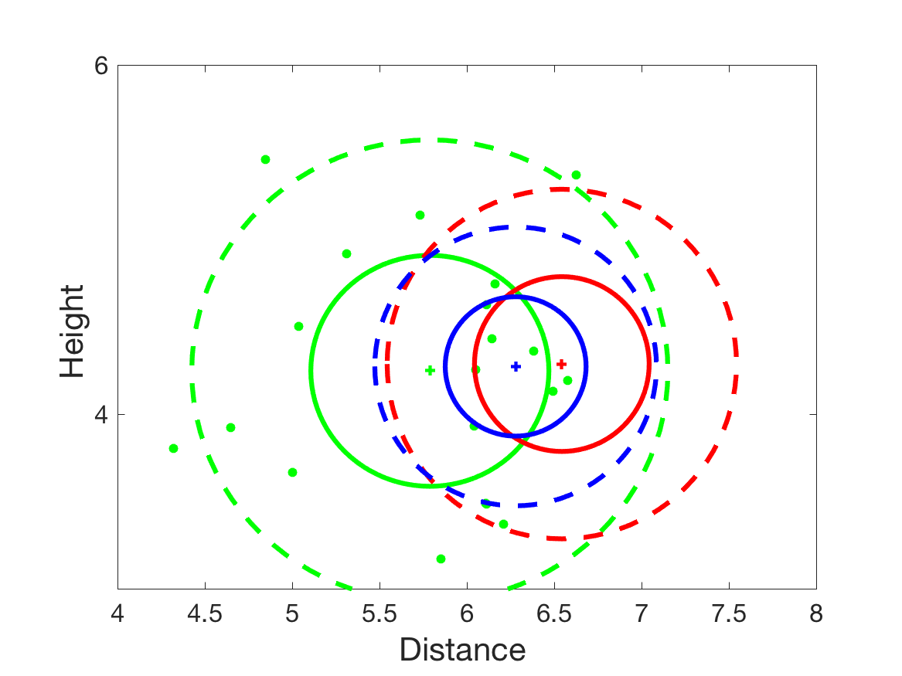
Methods: Ensemble Kalman Filter
Prior ensemble: fit a gaussian, sample mean and covariance (pdf is green contours).
Kalman filter product of observation likelihood (red) with prior (green) to get gaussian posterior (blue).

Slide 123
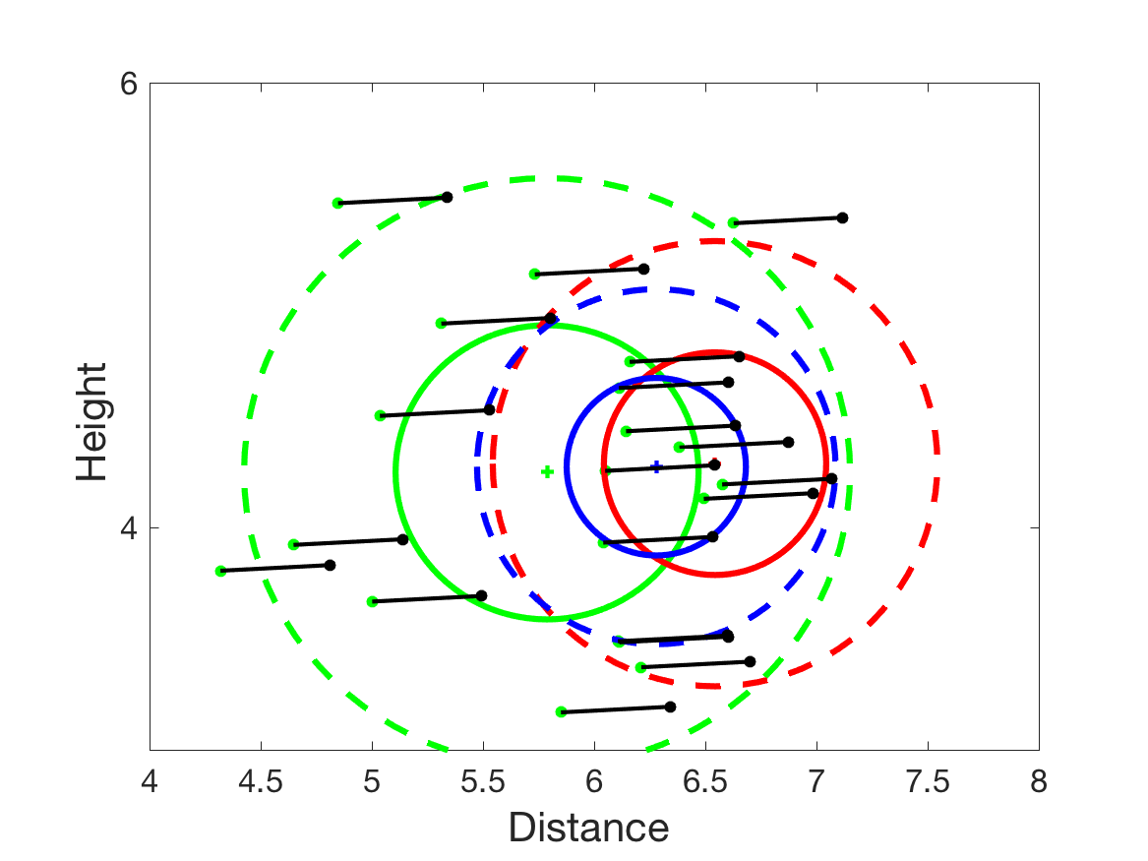
Methods: Ensemble Kalman Filter
Prior ensemble: fit a gaussian, sample mean and covariance (pdf is green contours).
Kalman filter product of observations (red) with prior (green) to get gaussian posterior (blue).
3. Shift ensemble members to have posterior mean.

Slide 124
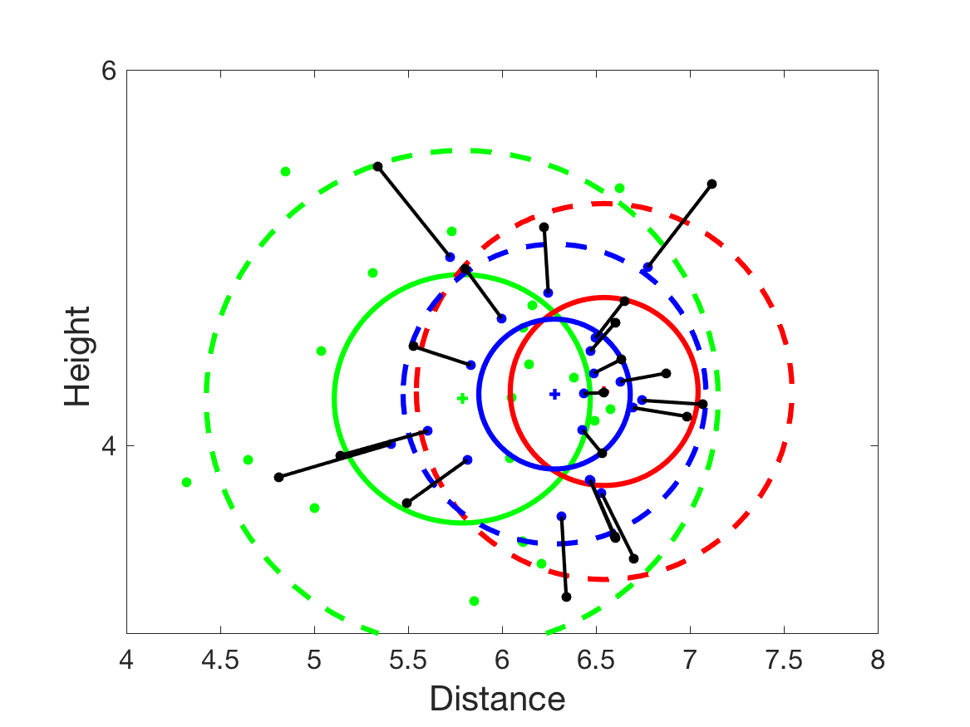
Methods: Ensemble Kalman Filter
Prior ensemble: fit a gaussian, sample mean and covariance (pdf is green contours).
Kalman filter product of observations (red) with prior (green) to get gaussian posterior (blue).
3. Shift ensemble members to have posterior mean.
4. Compact ensemble to have posterior covariance.

Slide 125
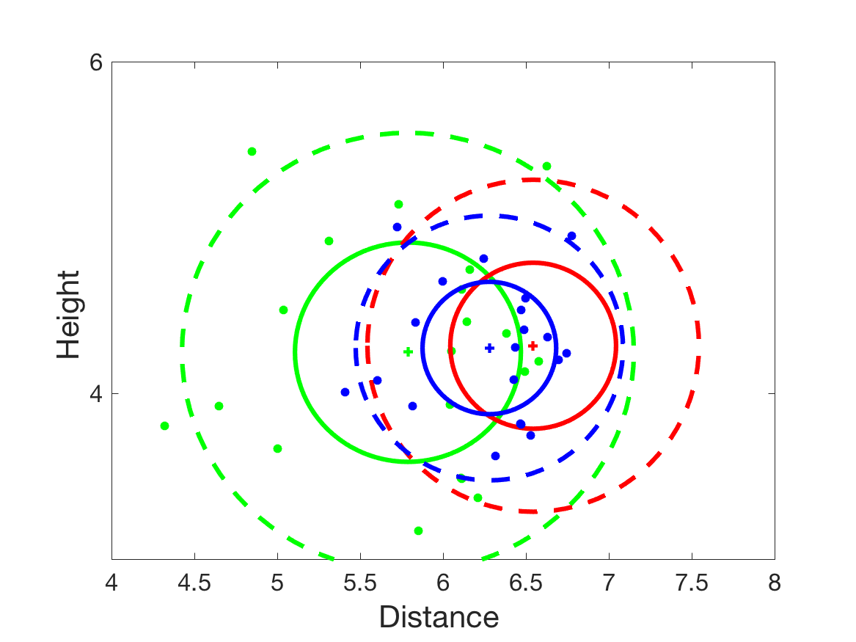
Methods: Ensemble Kalman Filter
Prior ensemble: fit a gaussian, sample mean and covariance (pdf is green contours).
Kalman filter product of observations (red) with prior (green) to get gaussian posterior (blue).
3. Shift ensemble members to have posterior mean.
4. Compact ensemble to have posterior covariance.

Slide 126
Methods: Ensemble Kalman Filter
20-member ensemble example.
Starts with random draw from uncertain thrower.
Quickly converges towards truth.

Slide 127
Methods: Ensemble Kalman Filter
20-member ensemble example.
Starts with random draw from uncertain thrower.
Quickly converges towards truth.

Slide 128
Methods: Ensemble Kalman Filter
20-member ensemble example.
Starts with random draw from uncertain thrower.
Quickly converges towards truth.

Slide 129
Methods: Ensemble Kalman Filter
20-member ensemble example.
Starts with random draw from uncertain thrower.
Quickly converges towards truth.

Slide 130
Methods: Ensemble Kalman Filter
20-member ensemble example.
Starts with random draw from uncertain thrower.
Quickly converges towards truth.

Slide 131
Methods: Ensemble Kalman Filter
20-member ensemble example.
Starts with random draw from uncertain thrower.
Quickly converges towards truth.

Slide 132
Methods: Ensemble Kalman Filter
20-member ensemble example.
Starts with random draw from uncertain thrower.
Quickly converges towards truth.

Slide 133
Methods: Ensemble Kalman Filter
20-member ensemble example.
Starts with random draw from uncertain thrower.
Quickly converges towards truth.

Slide 134
Methods: Ensemble Kalman Filter
Can be implemented with no matrix inversions.
Very fast compared to Kalman filter.
Fails for large models with small ensembles.
Can be fixed by ’localizing’ impact of observations.
Small ensembles have too little variance.
Can be fixed by ‘inflating’ ensembles.

Slide 135
Methods: Ensemble Kalman Filter
Capabilities:
Estimates some aspects of arbitrary probability distribution.
Easy to apply to any model, observation operators.
Works with huge models (see caveats below).
Challenges:
Sampling error leads to covariance errors.
Needs localization/inflation to work with
small ensembles/large models.
Prospects:
Hybrids with variational may have advantages.
Hybrids with particle filters may be better for non-gaussian.

Slide 136
Outline
Data Assimilation: Building a simple forecast system.
Data Assimilation: What can it do?
Data Assimilaton: A general description.
Methods: Particle filter.
Methods: Variational.
Methods: Kalman filter.
Methods: Ensemble Kalman filter.
Additional topics.

Slide 137
Learn more about DART at:
www.image.ucar.edu/DAReS/DART
dart@ucar.edu
Anderson, J., Hoar, T., Raeder, K., Liu, H., Collins, N., Torn, R., Arellano, A., 2009: The Data Assimilation Research Testbed: A community facility.
BAMS, 90, 1283—1296, doi: 10.1175/2009BAMS2618.1

