Slide 1

A Loosely Coupled Ocean-Atmosphere Ensemble Assimilation System.
Tim Hoar, Nancy Collins, Kevin Raeder, Jeffrey Anderson,
NCAR Institute for Math Applied to Geophysics
Data Assimilation Research Section
Steve Yeager, Mariana Vertenstein, Gokhan Danabasoglu, Alicia Karspeck, and Joe Tribbia
NCAR/NESL/CGD/Oceanography

Slide 2
Ocean Data Assimilation Motivation
The resulting high-fidelity ocean states are needed.
The ensembles provide uncertainty quantification.
Climate change over time scales of 1 to several decades has been identified as very important for mitigation and infrastructure planning.
High fidelity ocean states will be needed by the IPCC decadal prediction program.
The ocean plays a crucial role by providing a source or sink (and system memory) for the atmosphere of many quantities, such as heat, moisture, CO₂, etc.
Increasing numbers of observations from larger regions of the oceans are making state-of-the-art data assimilation a promising possibility.

Slide 3
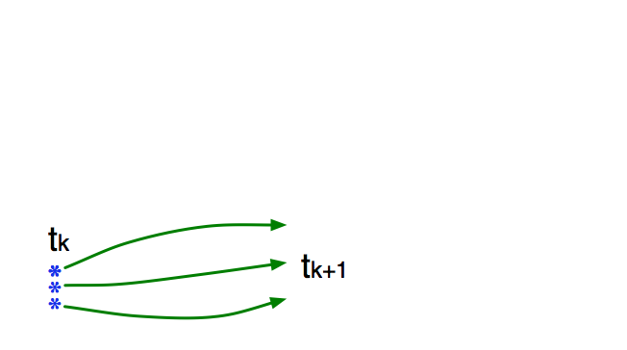
Ensemble Filter For Large Geophysical Models
1. Use model to advance ensemble (3 members here) to time at which next observation becomes available.
Ensemble state estimate, x(t_{k}), after using previous observation (analysis)
Ensemble state at time of next observation (prior)

Slide 4
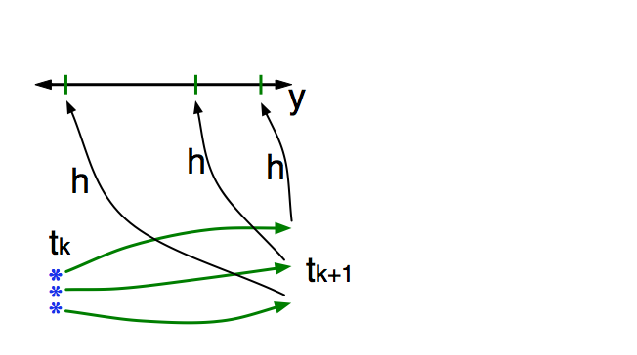
Ensemble Filter For Large Geophysical Models
2. Get prior ensemble sample of observation, y = h(x), by applying forward operator h to each ensemble member.
Theory: observations from instruments with uncorrelated errors can be done sequentially.

Slide 5
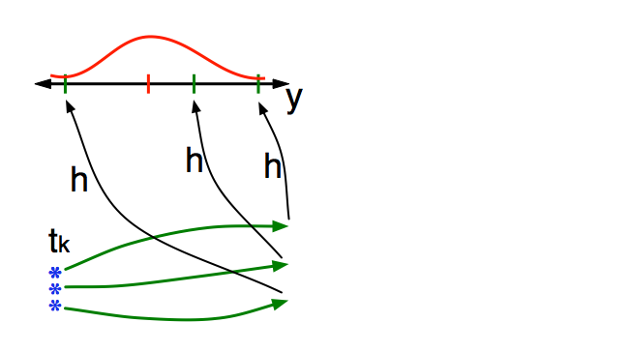
Ensemble Filter For Large Geophysical Models
3. Get observed value and observational error distribution from observing system.

Slide 6
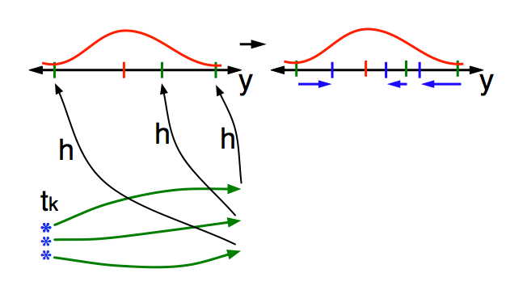
Ensemble Filter For Large Geophysical Models
  4. Compute the increments for the prior observation ensemble
  (this is a scalar problem for uncorrelated observation errors).
Note: Difference between various ensemble filters is primarily in observation increment calculation.

Slide 7
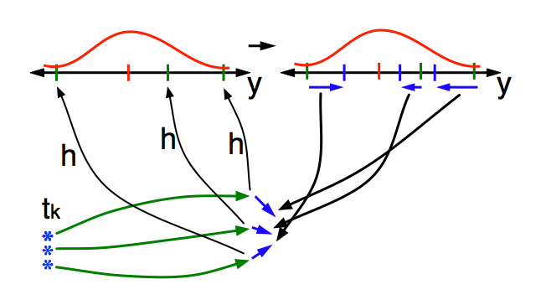
Ensemble Filter For Large Geophysical Models
5. Use ensemble samples of y and each state variable to linearly regress observation increments onto state variable increments.
Theory: impact of observation increments on each state variable can be handled independently!

Slide 8
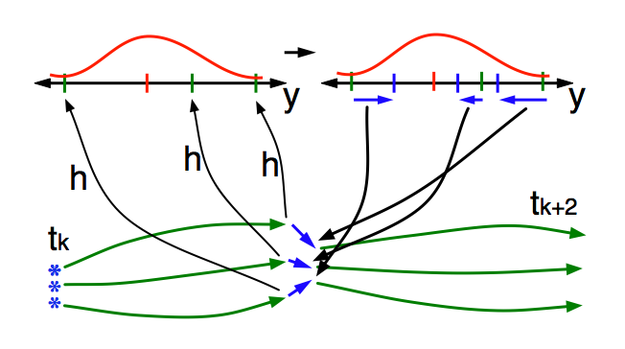
Ensemble Filter For Large Geophysical Models
6. When all ensemble members for each state variable are updated, there is a new analysis. Integrate to time of next observation …

Slide 9
Experiment Overview
Compare the effect of using a single atmospheric boundary vs. an ensemble of atmospheric boundaries on ocean data assimilation with POP.
“23 POP 1 DATM” denotes the experiment using 23 POP members and a single “data” atmosphere (CESM framework).
“48 POP 48 CAM” denotes the loosely coupled experiment using 48 POP members and 48 consistent but unique CAM atmospheres.
Both experiments were conducted for 1998 & 1999.
The 48 POP 48 CAM experiment was subsequently chosen to produce initial conditions for the IPCC decadal prediction program.

Slide 10
Coupled Ocean-Atmosphere Schematic
Obs used by
NCAR-NCEP
reanalyses
CESM1 coupler
history files:
atmospheric forcing
DART/CAM
assimilation
system
DART/POP
assimilation
system
Hadley +
NCEP-OI2
SSTs
World Ocean
Database
Observations
CAM analyses:
CAM initial files; posterior ensemble mean of state variables
prior ensemble mean of all other variables
CLM restart files; prior ensemble mean of all variables
CICE restart files; prior ensemble mean of all variables
POP analyses:
temperature,
salinity,
velocities,
surface height
CAM state variables = PS, T, U, V, Q, CLDLIQ, CLDICE
Prior = values before assimilation (but after a short forecast)
Posterior = values after the assimilation of observations at that time
Notes:
The big picture is that we do an atmospheric assimilation first,
and use the resulting surface fluxes as atmospheric forcing for an ocean assimilation.
The atmospheric assimilation uses a single SST Analysis, but generates an ensemble of forcings for POP/DART.
Both assimilations generate an ensemble of analyses, each member of which is an equally valid
estimate of the physical system.

Slide 11
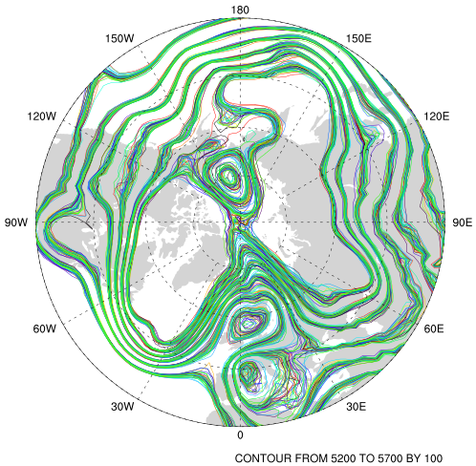
Atmospheric Reanalysis
O(1 million) atmospheric obs are assimilated every day.
Assimilation uses 80 members of 2º FV CAM forced by a single ocean (Hadley+ NCEP-OI2) and produces a very competitive reanalysis.
500 hPa GPH
Feb 17 2003
Generates additional ocean spread.
Each POP ensemble member is forced with a different atmospheric reanalysis member.

Slide 12
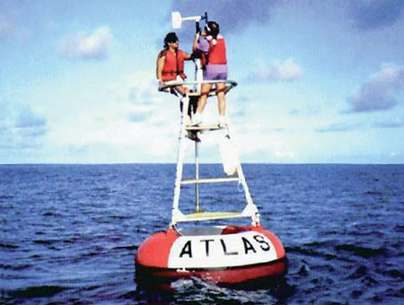
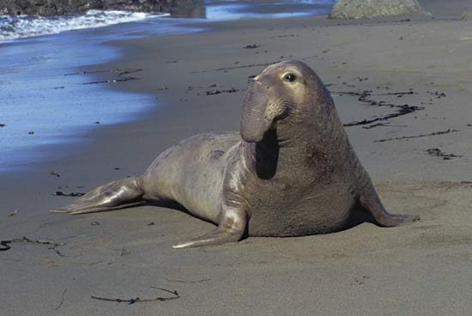
World Ocean Database T,S observation counts
These counts are for 1998 & 1999 and are representative.
FLOAT_SALINITY 68200
FLOAT_TEMPERATURE 395032
DRIFTER_TEMPERATURE 33963
MOORING_SALINITY 27476
MOORING_TEMPERATURE 623967
BOTTLE_SALINITY 79855
BOTTLE_TEMPERATURE 81488
CTD_SALINITY 328812
CTD_TEMPERATURE 368715
STD_SALINITY 674
STD_TEMPERATURE 677
XCTD_SALINITY 3328
XCTD_TEMPERATURE 5790
MBT_TEMPERATURE 58206
XBT_TEMPERATURE 1093330
APB_TEMPERATURE 580111
temperature observation error standard deviation == 0.5 K.
salinity observation error standard deviation == 0.5 msu.

Slide 13
Experimental Configurations
23 POP 1 DATM
POP 1-degree displaced pole;
23 ensemble members starting from a ‘climatological’ state;
Single ‘data’ atmosphere from CORE;
DART assimilates observations once per day in a +/- 12 hour window centered at midnight;
The CESM framework is responsible for all model advances.
The 48 POP 48 CAM experiment differed in that:
48 ensemble members starting from a ‘climatological’ state;
Atmospheric forcing from the DART/CAM ensemble reanalysis;
Guide to the following figures:
Ensemble mean 1-day lead forecast difference from observations.
is # observations available; +,+ is # assimilated.
Obs are rejected if too far from ensemble mean (3 std dev here).
Notes:
The early DART-POP cases were forced with the Coordinated Ocean-ice Reference Experiments (CORE)
atmospheric data sets from Large and Yeager (2009). The data sets vary interannually.
@article{Large+Yeager09,
author = {W. G. Large and S. G. Yeager},
title = {The global climatology of an interannually varying air-sea flux data set},
journal = {Clim. Dyn.}, year = {2009}, volume = 33, pages = {341--364},
doi = {10.1007/s00382-008-0441-3} }

Slide 14
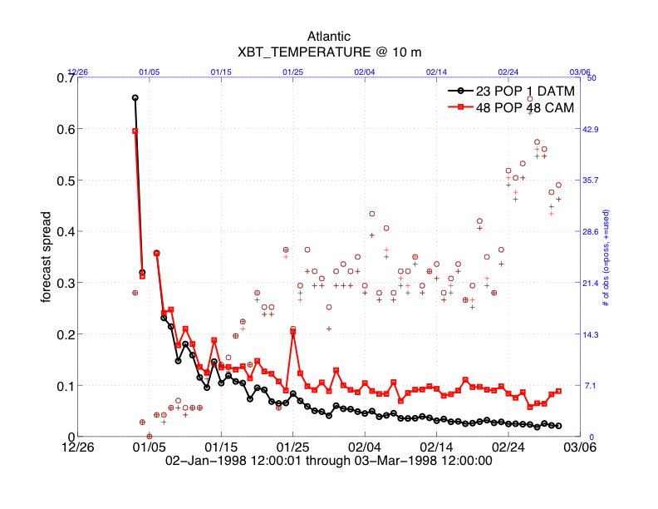
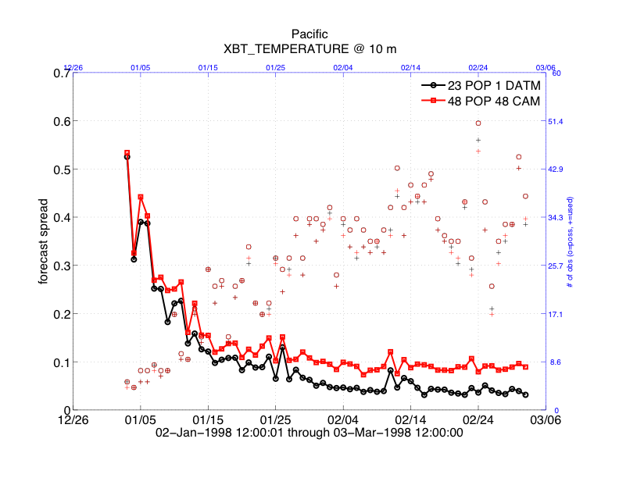
Ensemble Spread for 100m XBT (Expendable Bathythermograph)
Spread contracts too much for 23 POP 1 DATM;
Using single atmospheric forcing is also part of the problem;
Model bias adds to the problem;
DART Statistical Sampling Error Correction also helps.
Pacific
Atlantic

Slide 15
Ensemble Spread for Pacific 100m XBT
Spread of the “climatological” ensemble
In general, larger spread rejects fewer obs
Twice as much!
Small spread!

Slide 16
Ensemble Spread for Atlantic 100m XBT
In general, larger spread rejects fewer obs
Twice as much!
Small spread!

Slide 17
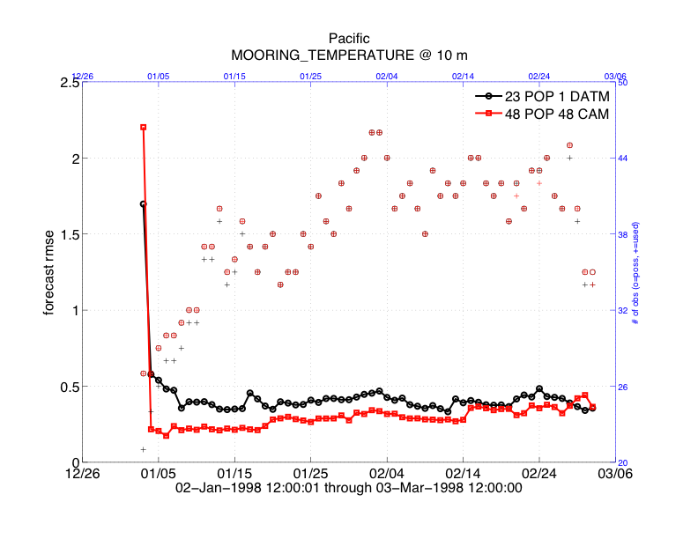
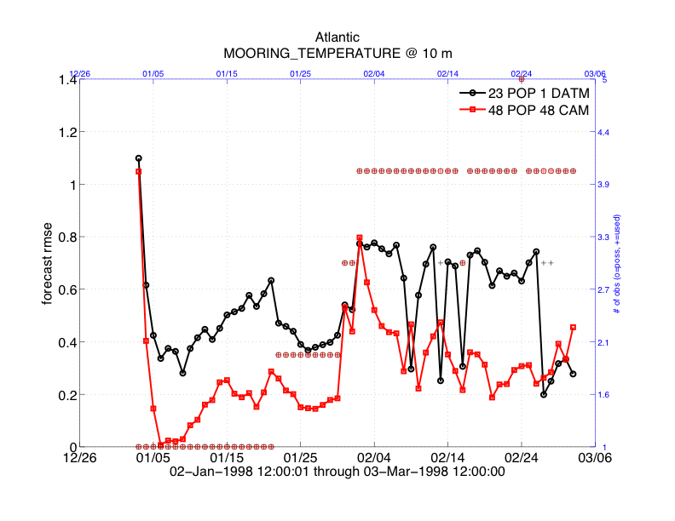
10m Mooring Temperature RMSE
Ensemble mean 1-day lead forecast difference from observations.
is # observations available. +,+ is # assimilated.
Observations are rejected if they are too far from ensemble mean
(3 standard deviations here).
Pacific
Atlantic
Notes:
Smaller ens size; higher variability, sometimes smaller number of obs used in rmse (not here though)

Slide 18
10m Mooring Temperature RMSE – Pacific
Ensemble mean 1-day lead forecast difference from observations.
Similar observation rejection characteristics
POP/CAM as good or better RMSE
Notes:
Smaller ens size; higher variability, sometimes smaller number of obs used in rmse (not here though)

Slide 19
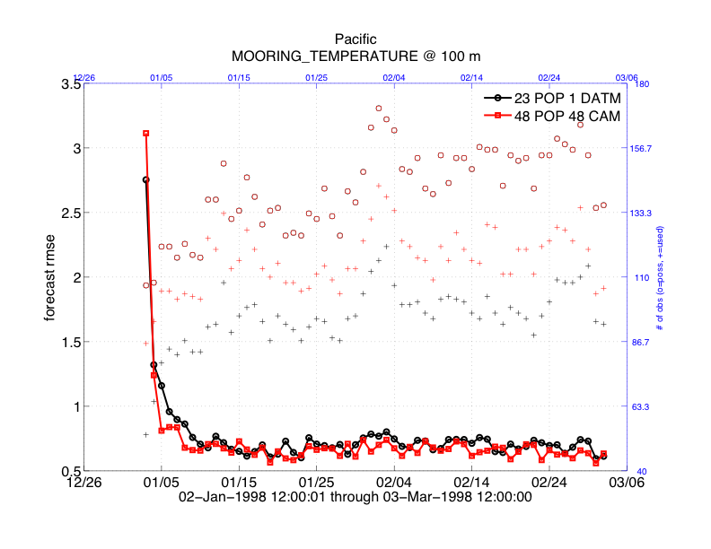
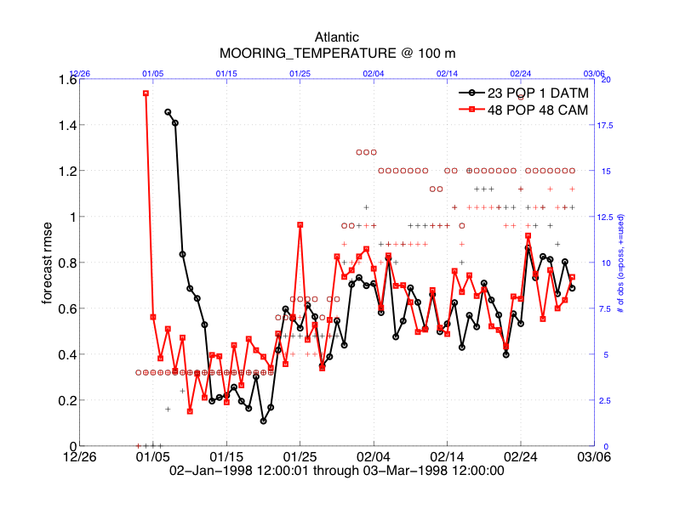
100m Mooring Temperature RMSE
1/3 of the obs are still rejected by 48 POP 48 CAM in the Pacific.
Model bias in the thermocline?
Pacific
Atlantic

Slide 20
100m Mooring Temperature RMSE – Pacific
Many observations still not assimilated
POP/CAM as good or better RMSE

Slide 21
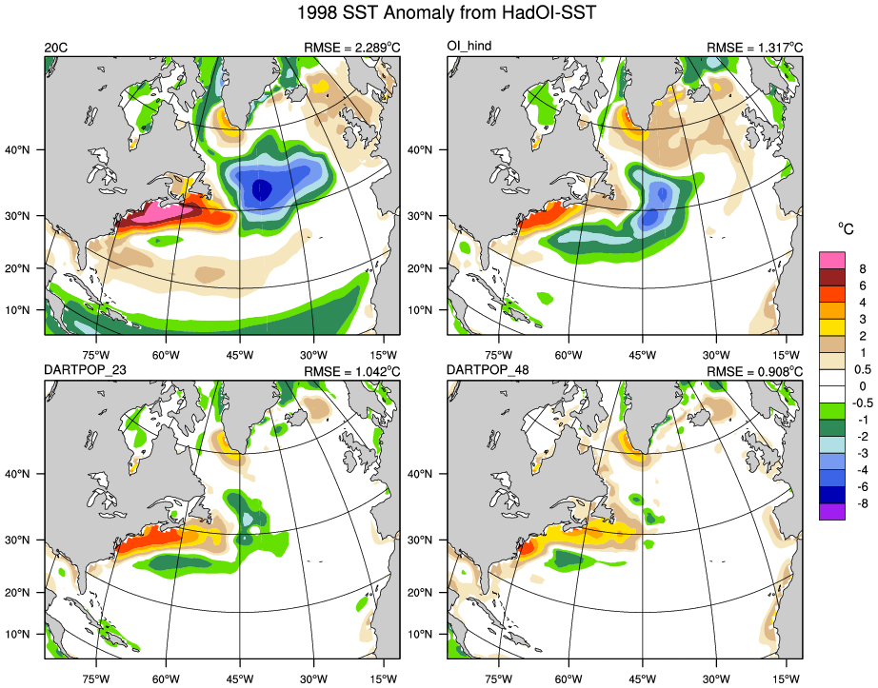
Physical Space: 1998/1999 SST Anomaly from HadOI-SST
POP forced by observed atmosphere (hindcast)
Coupled Free Run
48 POP 48 CAM
23 POP 1 DATM

Slide 22
Learn about ensemble assimilation and DART tools at:
http://www.image.ucar.edu/DAReS/DART/
Anderson, J., Hoar, T., Raeder, K., Liu, H., Collins, N., Torn, R., Arellano, A., 2009: The Data Assimilation Research Testbed: A community facility. BAMS, 90, 1283—1296, doi: 10.1175/2009BAMS2618.1

Slide 23
End of Presentation, following slides held in reserve.

Slide 24
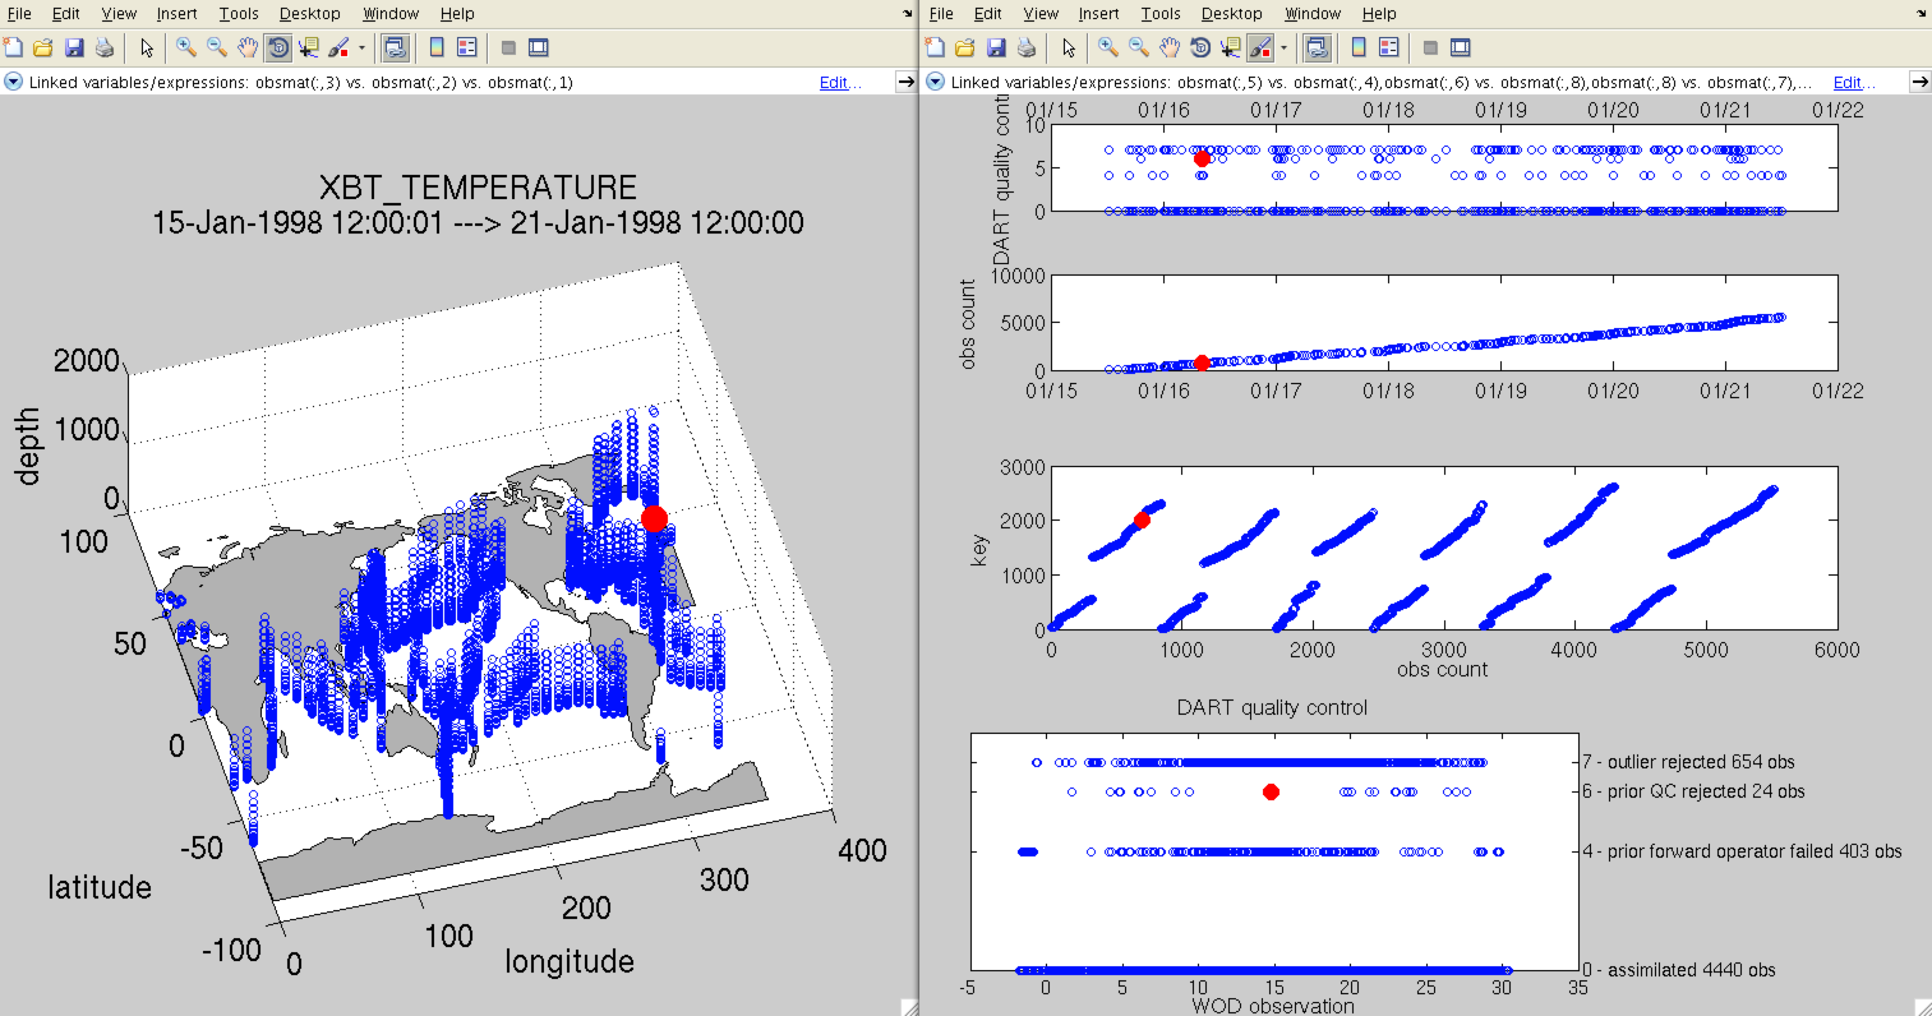
Observation Visualization Tools
Notes:
Selected obs were chosen by prior QC==6 incoming QC undesirable

Slide 25
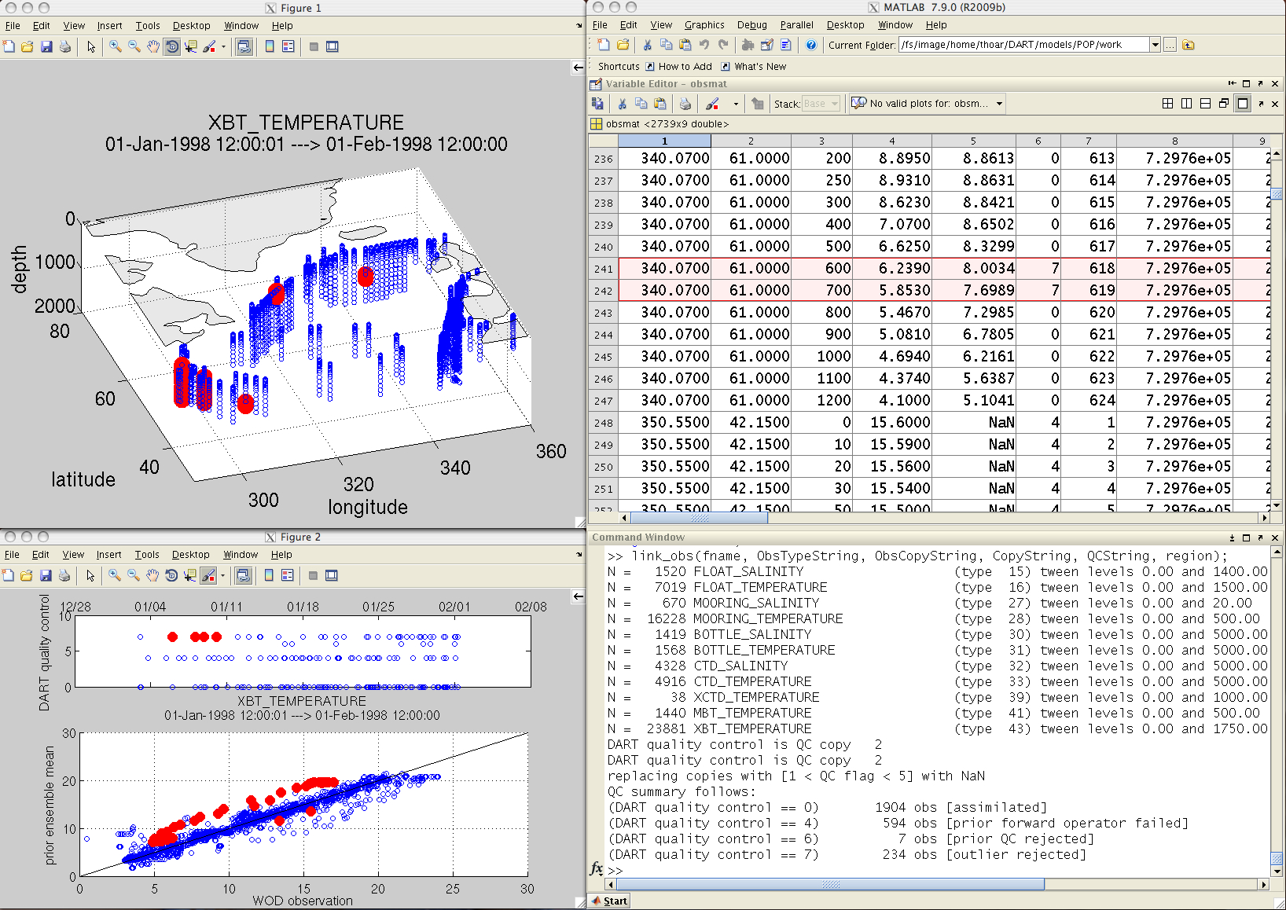
Observation Visualization Tools
Notes:
The red dots here indicate all the observations rejected by DART (selected by QC==7) outlier threshhold

Slide 26
The CAM-DART-POP Implementation
Uses the CESM1 software framework; ocean, atmosphere, and other components communicate through the coupler. A few minor script changes and use of the interactive ensemble capability permit each member of an ensemble of POPs to be forced by a different CAM atmosphere.
Once the additional files are staged, the basic implementation is a trivial addition to the run script that invokes the DART system.
# ------------------------------------------------------------------
# See if CSM finishes correctly (pirated from ccsm_postrun.csh)
# ------------------------------------------------------------------
# DART assimilation operating on restarts
# ------------------------------------------------------------------
grep 'SUCCESSFUL TERMINATION' $CplLogFile
if ( $status == 0 ) then
${CASEROOT}/assimilate.csh
endif

